Slide 1
2024 Planning and Development Division
Andrew Allen, Director of Planning and Development

Slide 2
Division Overview
Development Services
Building Inspection
Bylaw Enforcement

Slide 3
2023 Operating Review
Development Services
Application Fees - $90,000
Pending Amenity Contributions:
Mills Rd - $57,500
Shoal Way –$580,000 or equivalent of discounted units
Reef Road – $235,000
Derby Road – $260,000
Tower Road - $162,500
Notes:
1.3 million

Slide 4
2023 Operating Review
Building Inspection
Permit Application Fees - $892,000
Bylaw Enforcement
License Revenue – $251,553
Fines - $21,977
Notes:
2022 – License revenue 115,293 Fines – 12,000 (October),
2021 – License revenue 132,843, Fines – 4,165

Slide 5
2023 Operating Review
Staff Summary
Sr. Policy Planner vacant for eight months and now filled
Third Bylaw Officer added in July
Building Official position vacant from July to November
Sr. Development Planner presently vacant
Notes:
One vacancy to fill and Planning to enter 2024 with a complete team

Slide 6
2023 Operating Review
Short-term rental implementation
Water Summit planning team
Transportation Plan
Housing Accelerator Fund
Progress on Housing and rental projects

Slide 7
2024 Operational requests
Official Community Plan – high priority
Mobile Ticket Tablets and Printers – medium priority
GIS development files – low priority

Slide 8
2024 Operational Projects
Official Community Plan Review – into 2025
Zoning Bylaw Amendments for Housing (Bill 44) – June 2024
Housing Needs Assessment Update – December 2024
Notes:
*And Short-Term Rental Accommodations Act
Direct links to Strat. Plan and Provincial Req.

Slide 9
External Funding Sources
Housing Accelerator Fund – Announcement Pending
Provincial Funding for Zoning Changes – Share of $51 million to be announced in January
Complete Communities Fund and
Local Government Development Approvals Program

Slide 10
2024 Operational Projects
Regional Projects
Water Summits
Coast-wide flood mapping
Coast-wide OCP renewals with focus on regional growth, housing needs, climate action and environmental protection awareness
Emergency preparedness:
  Hazard, Risk and Vulnerability Assessment
  Heat Response Plan
  Evacuation Planning

Slide 11
Questions?

Slide 12
2024 Budget Presentation
Corporate & Community Services
Lindsay Roberts
Director of Corporate and Community Services

Slide 13

Division Overview
New Division for the District of Sechelt in 2023
Community Services
  Parks
  Arts and Culture
  Facilities and Events
Communications
Corporate Services
Human Resources

Slide 14
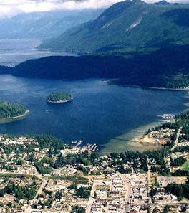
2023 Operating Review
Highlights:
New division ☺
New Corporate Officer
Hackett park amphitheater
Jane Bowers dog park
Second annual Siyaya days
Community Safety Committee
Escribe
Internal newsletter
Training and development for staff including the introduction of the culture club.

Slide 15

2024 Operational requests
Proposed Staff
  Parks Maintenance (two) Parks
  Facilities Maintenance Public Works
  Development technologist Engineering
  Community Safety Coordinator
  RCMP

Slide 16

2024 Operational Projects
Share point
Community Services Master Plan
Managing people training and delivery
Communications plan in conjunction with the solidified strategic plan

Slide 17
2024 Capital Carry Forward Projects
Parks
Trail bay sidewalk
Parks infrastructure renewal
Irrigation system upgrades
Annual trail renewal
New equipment for Hackett park outdoor stage
Sandy Hook tot park gazebo

Slide 18
2024 Capital Requests
Parks:
Kinnikinnick park ground water well
Friendship park washroom renewal
Park/playground improvements
Facilities:
Refinish concrete floor (Seaside)
Drainage repairs (Rockwood)
Accessibility upgrades (District-wide)

Slide 19
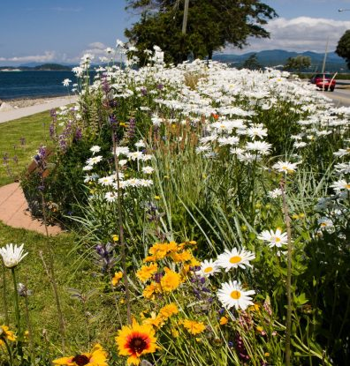
Conclusion
The division of Corporate and Community Services created change in 2023. We are planning for a collaborative and cohesive 2024. We are working to be in line with the council strategic plan as a cohesive division, reaching our goals and continuing to contribute to the community.

Slide 20
2024 ENGINEERING AND OPERATIONS
Budget Presentation
Kirn Dhillon
Director of Engineering and Operations

Slide 21
Division Overview
ENGINEERING
PROJECTS
PUBLIC WORKS
WASTEWATER
SUSTAINABLE INFRASTRUCTURE

Slide 22
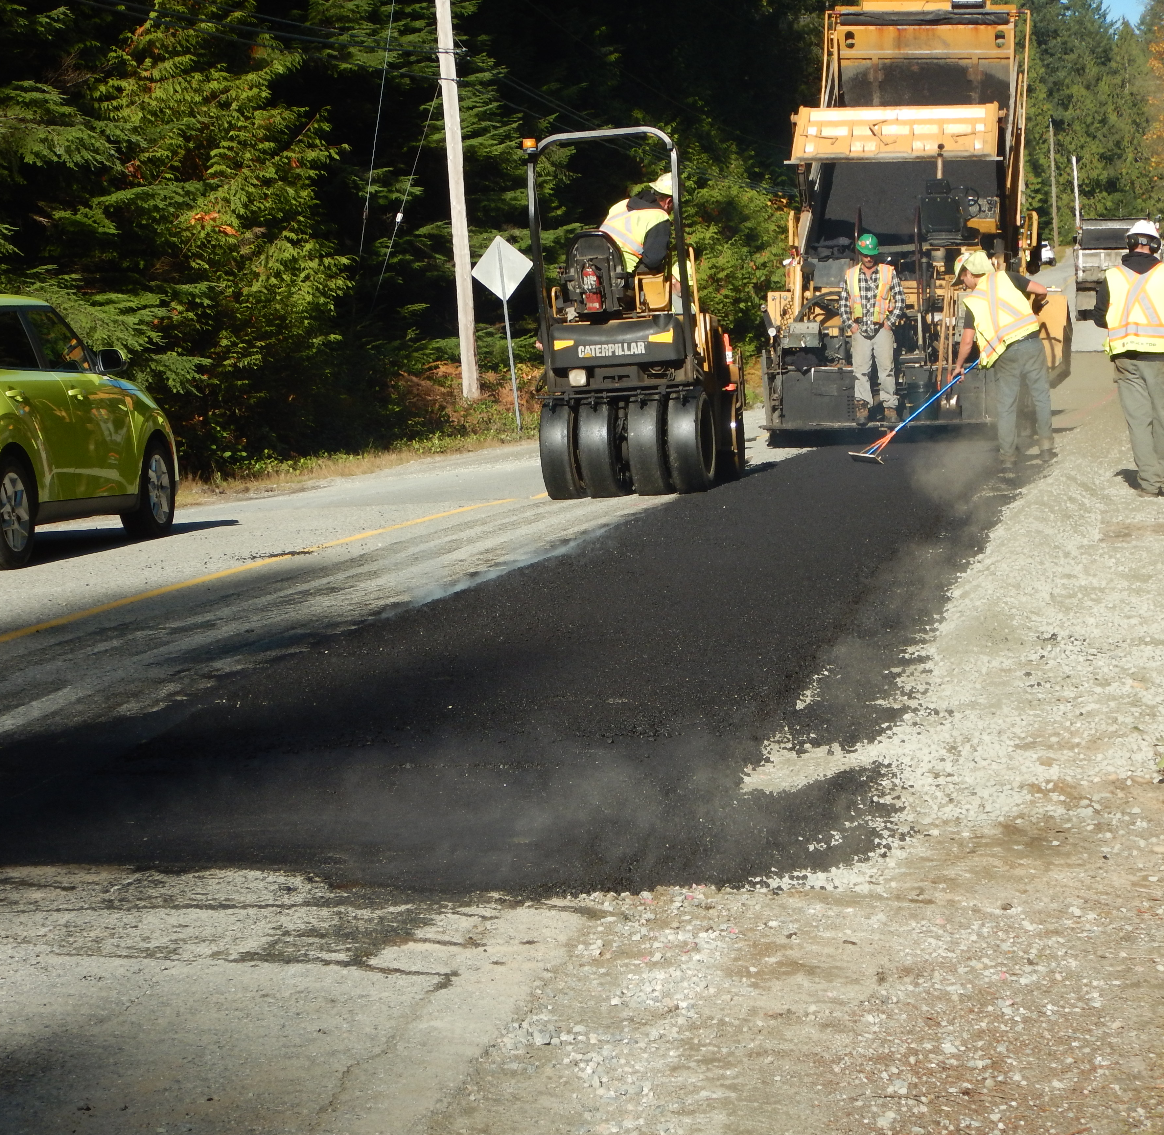
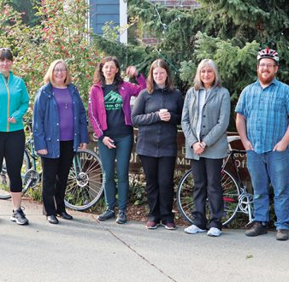
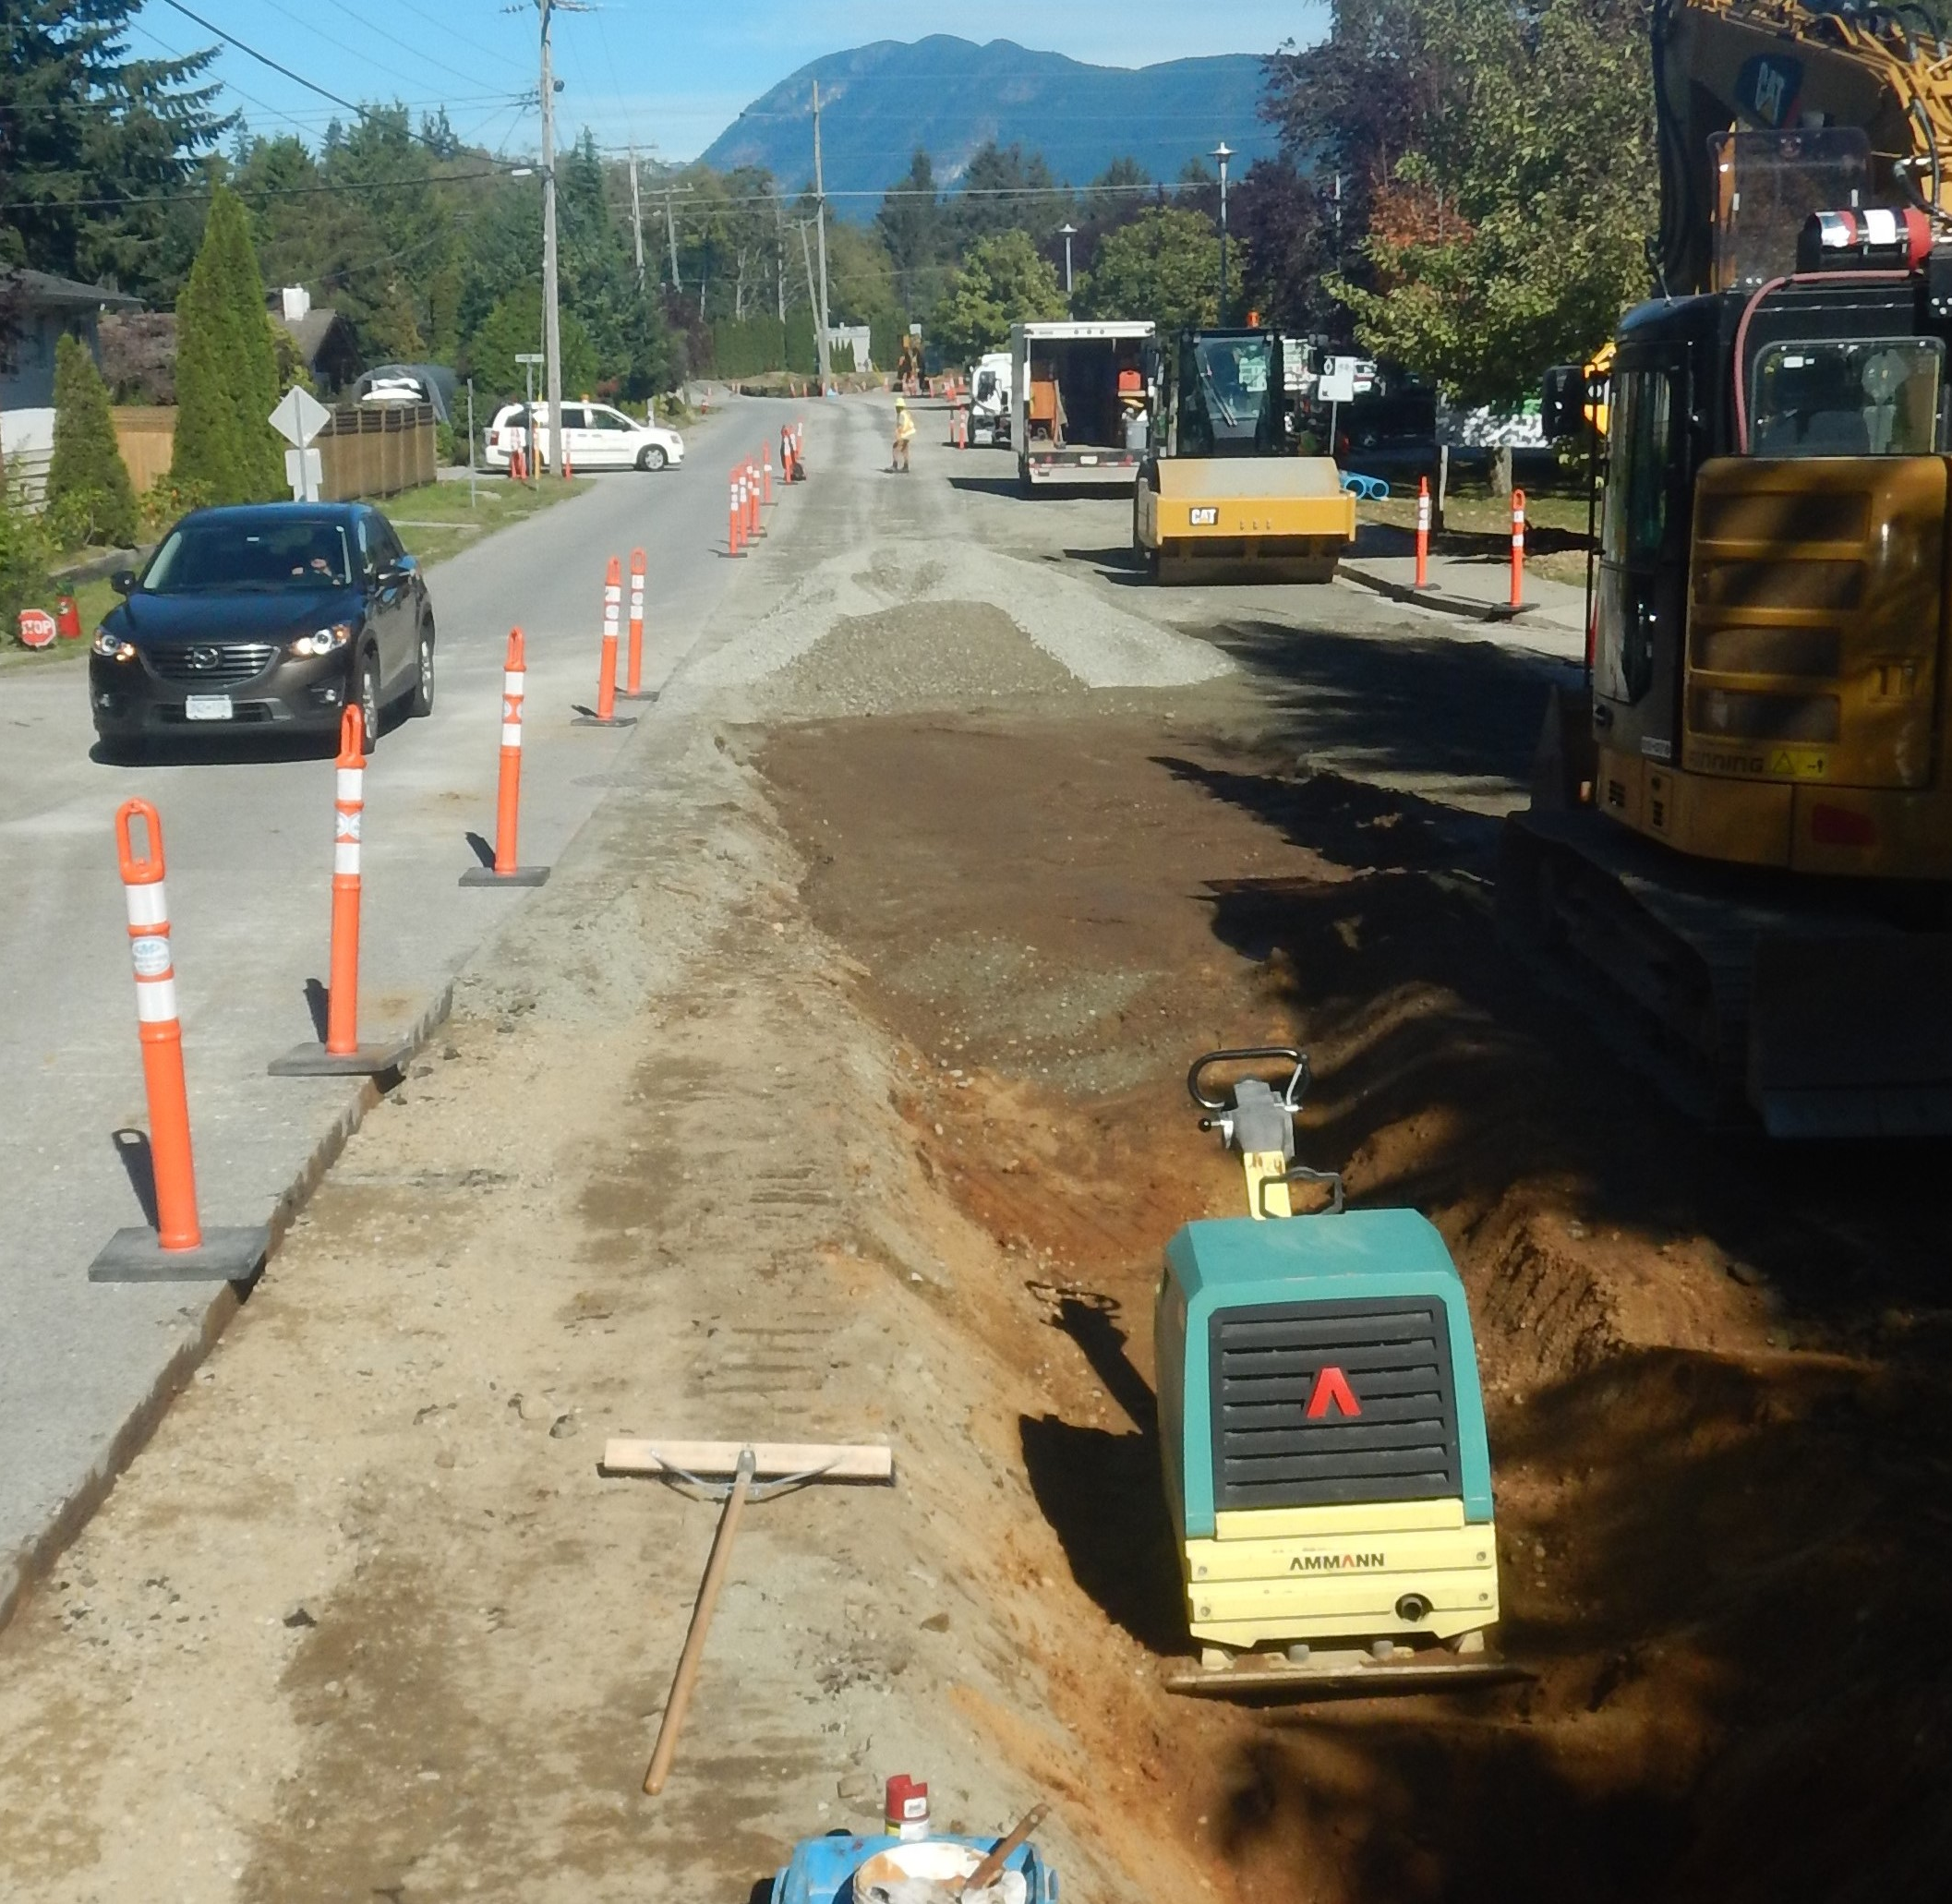
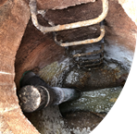
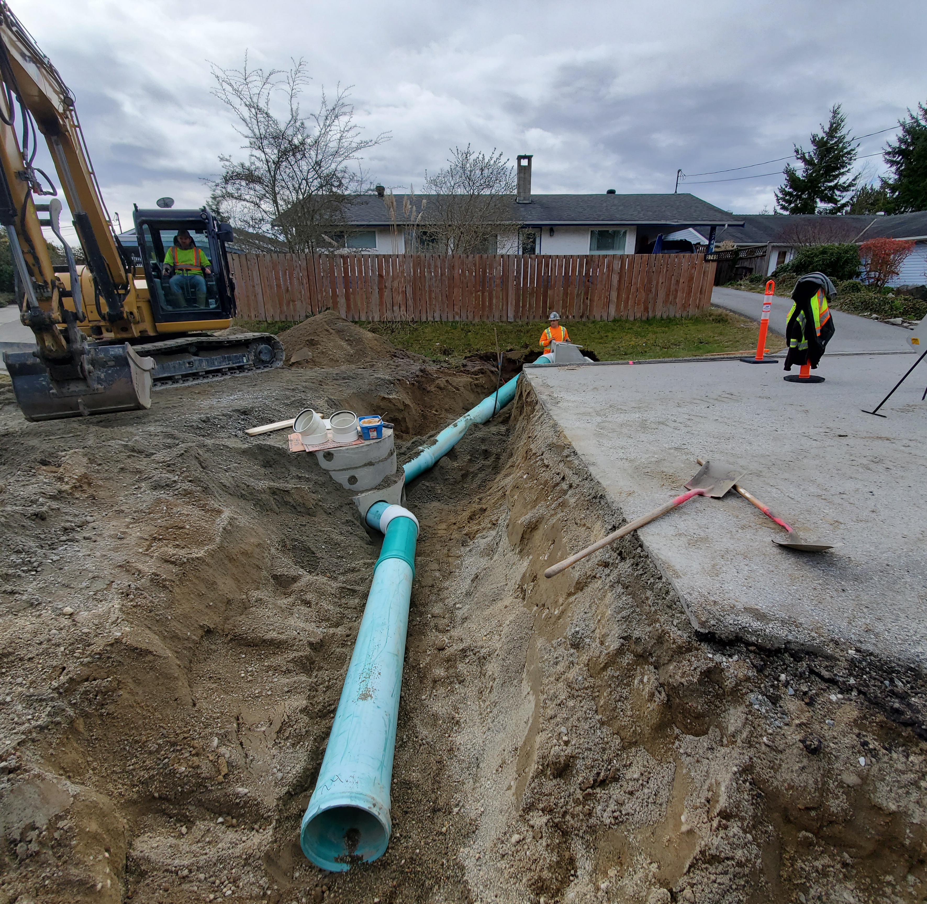
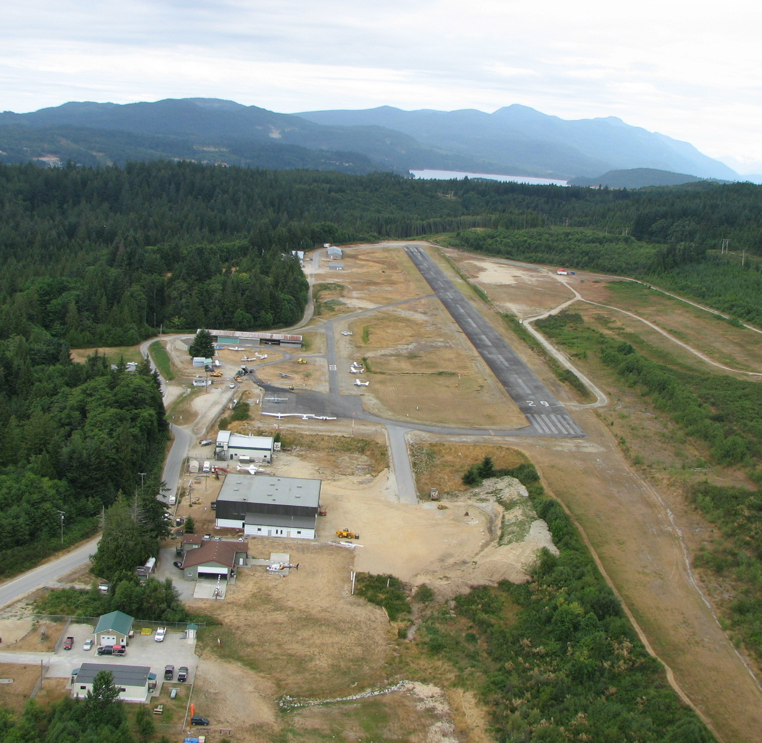
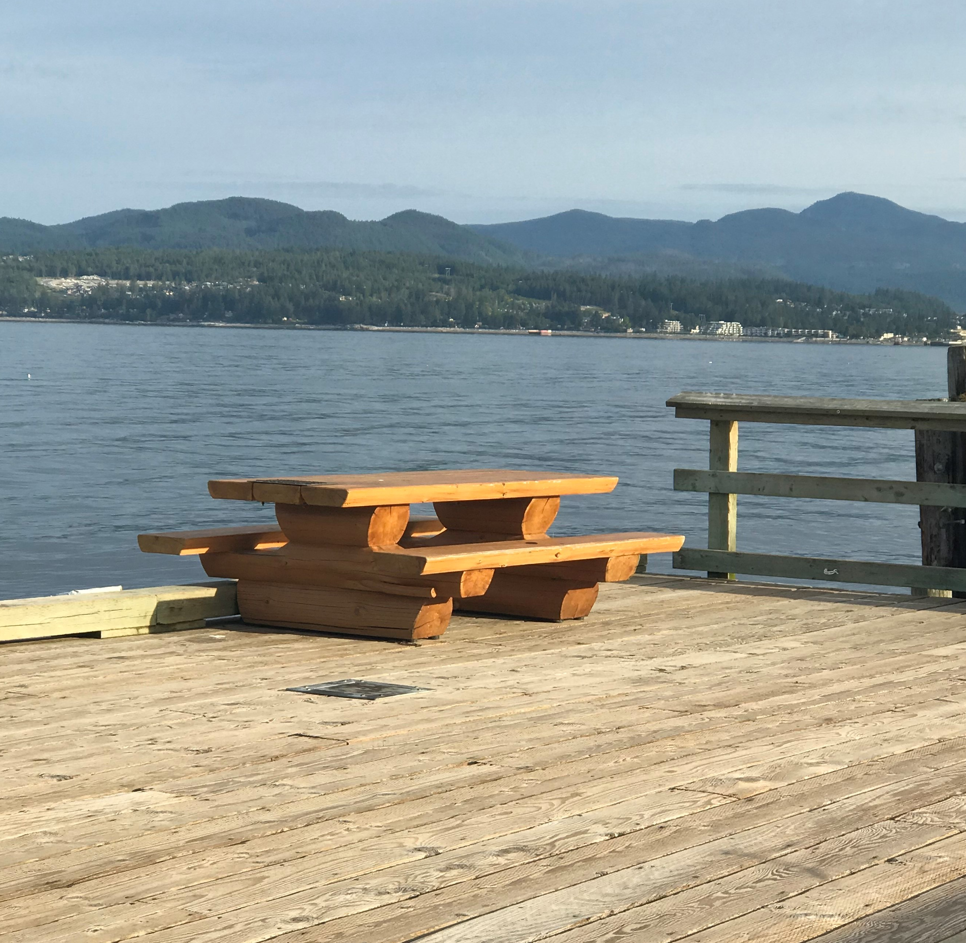
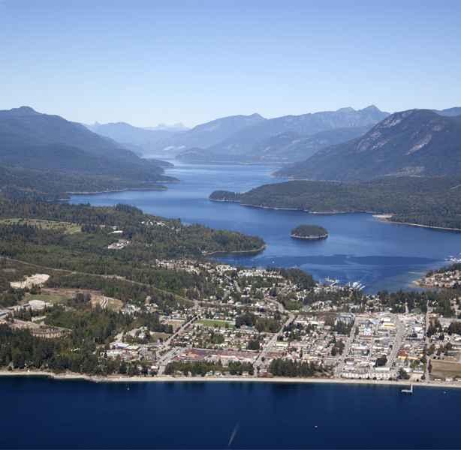
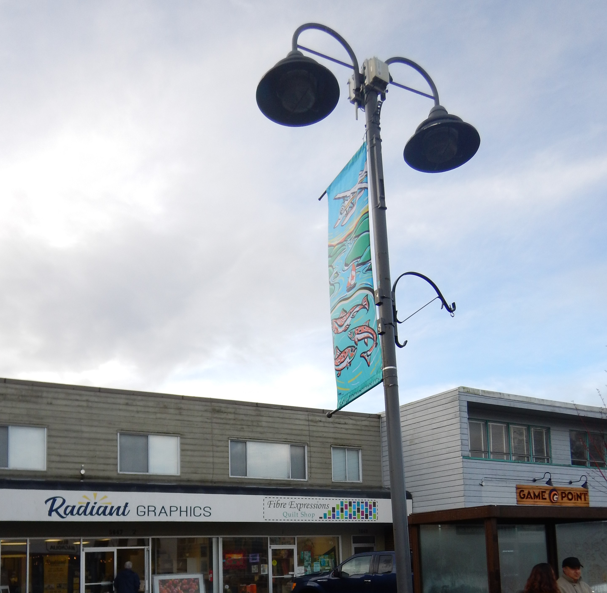
ENGINEERING PROJECTS
ACTIVE TRANSPORTATION
PROJECTS
SANITARY AND STORM SEWER RENEWAL
PAVEMENT MANAGEMENT
MAJOR
MUNICIPAL CONSTRUCTION
WASTEWATER
AIRPORT
BRIDGES, CULVERTS, AND WHARVES
DOWNTOWN INFRASTRUCTURE REVITALIZATION
TRANSPORTATION SAFETY AND STREETLIGHTS
This Photo by Unknown Author is licensed under CC BY-SA
This Photo by Unknown Author is licensed under CC BY-SA

Slide 23
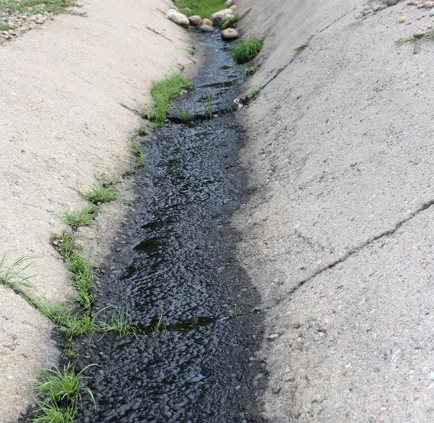
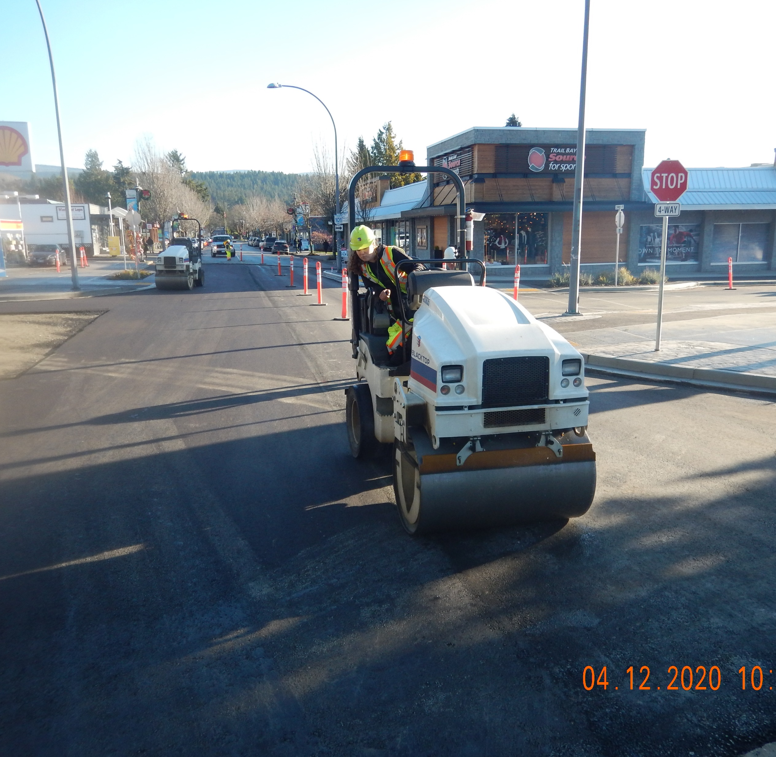
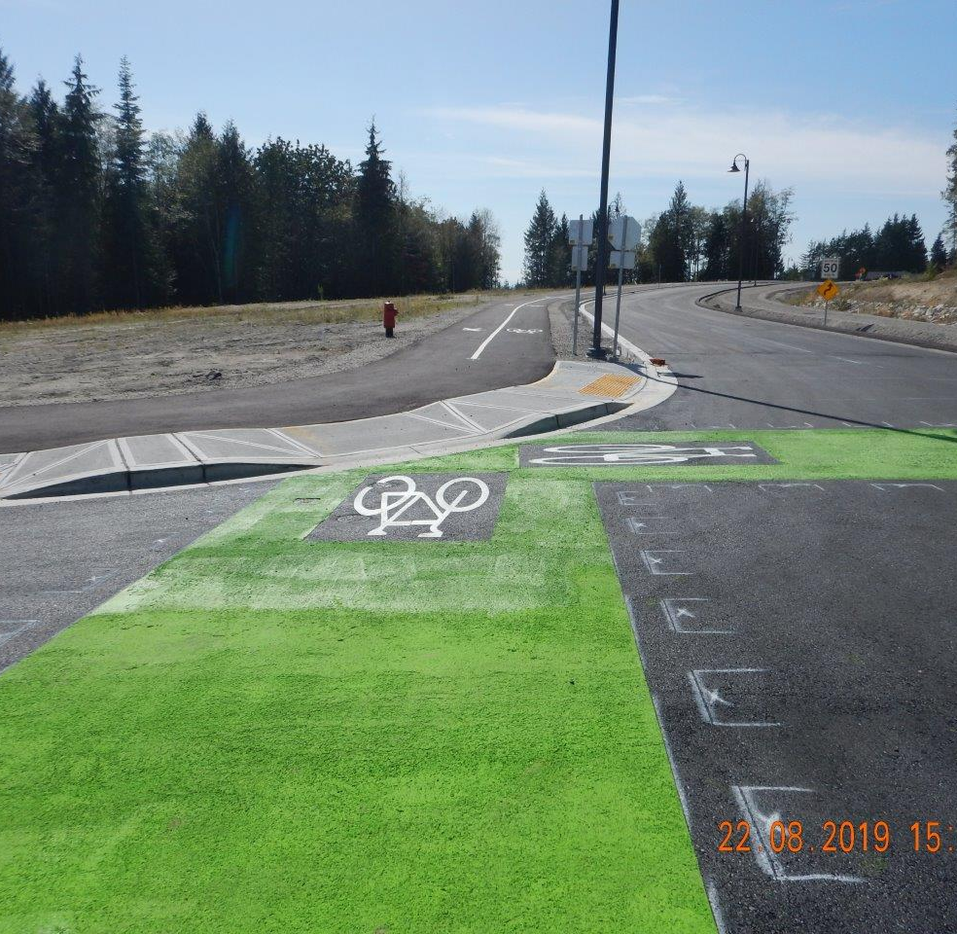
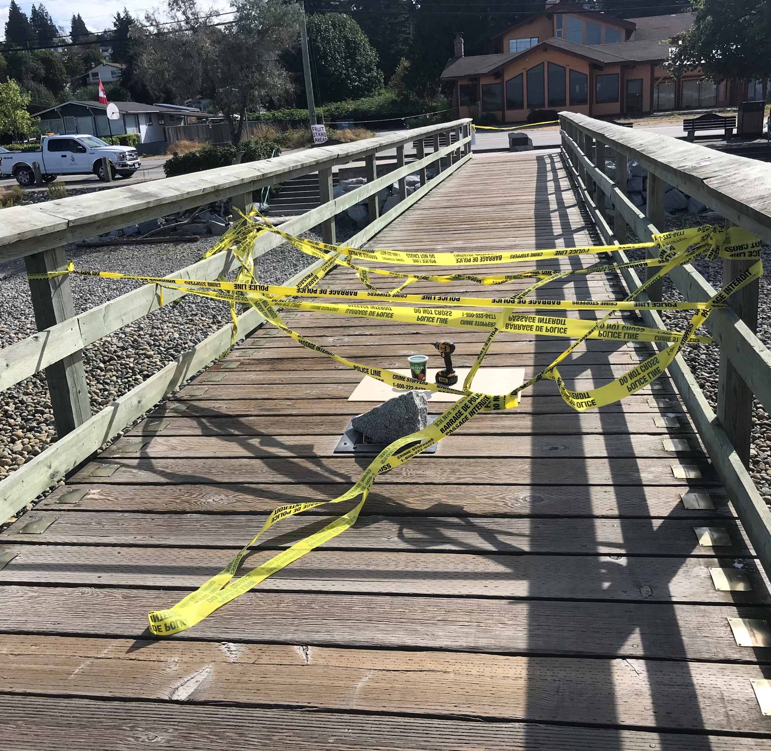
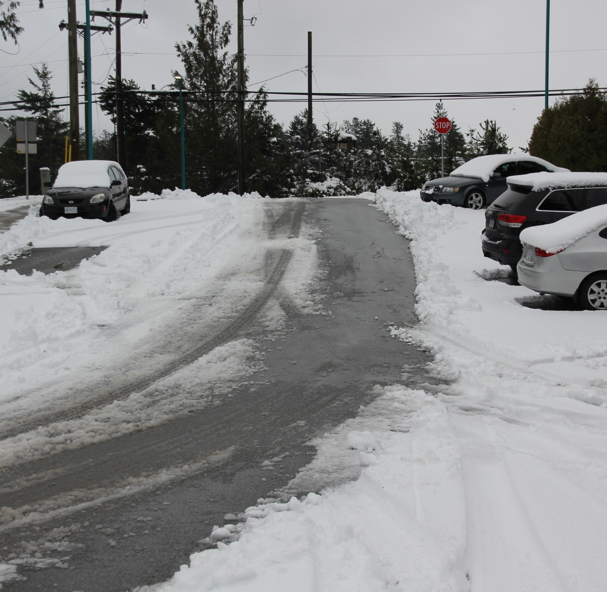
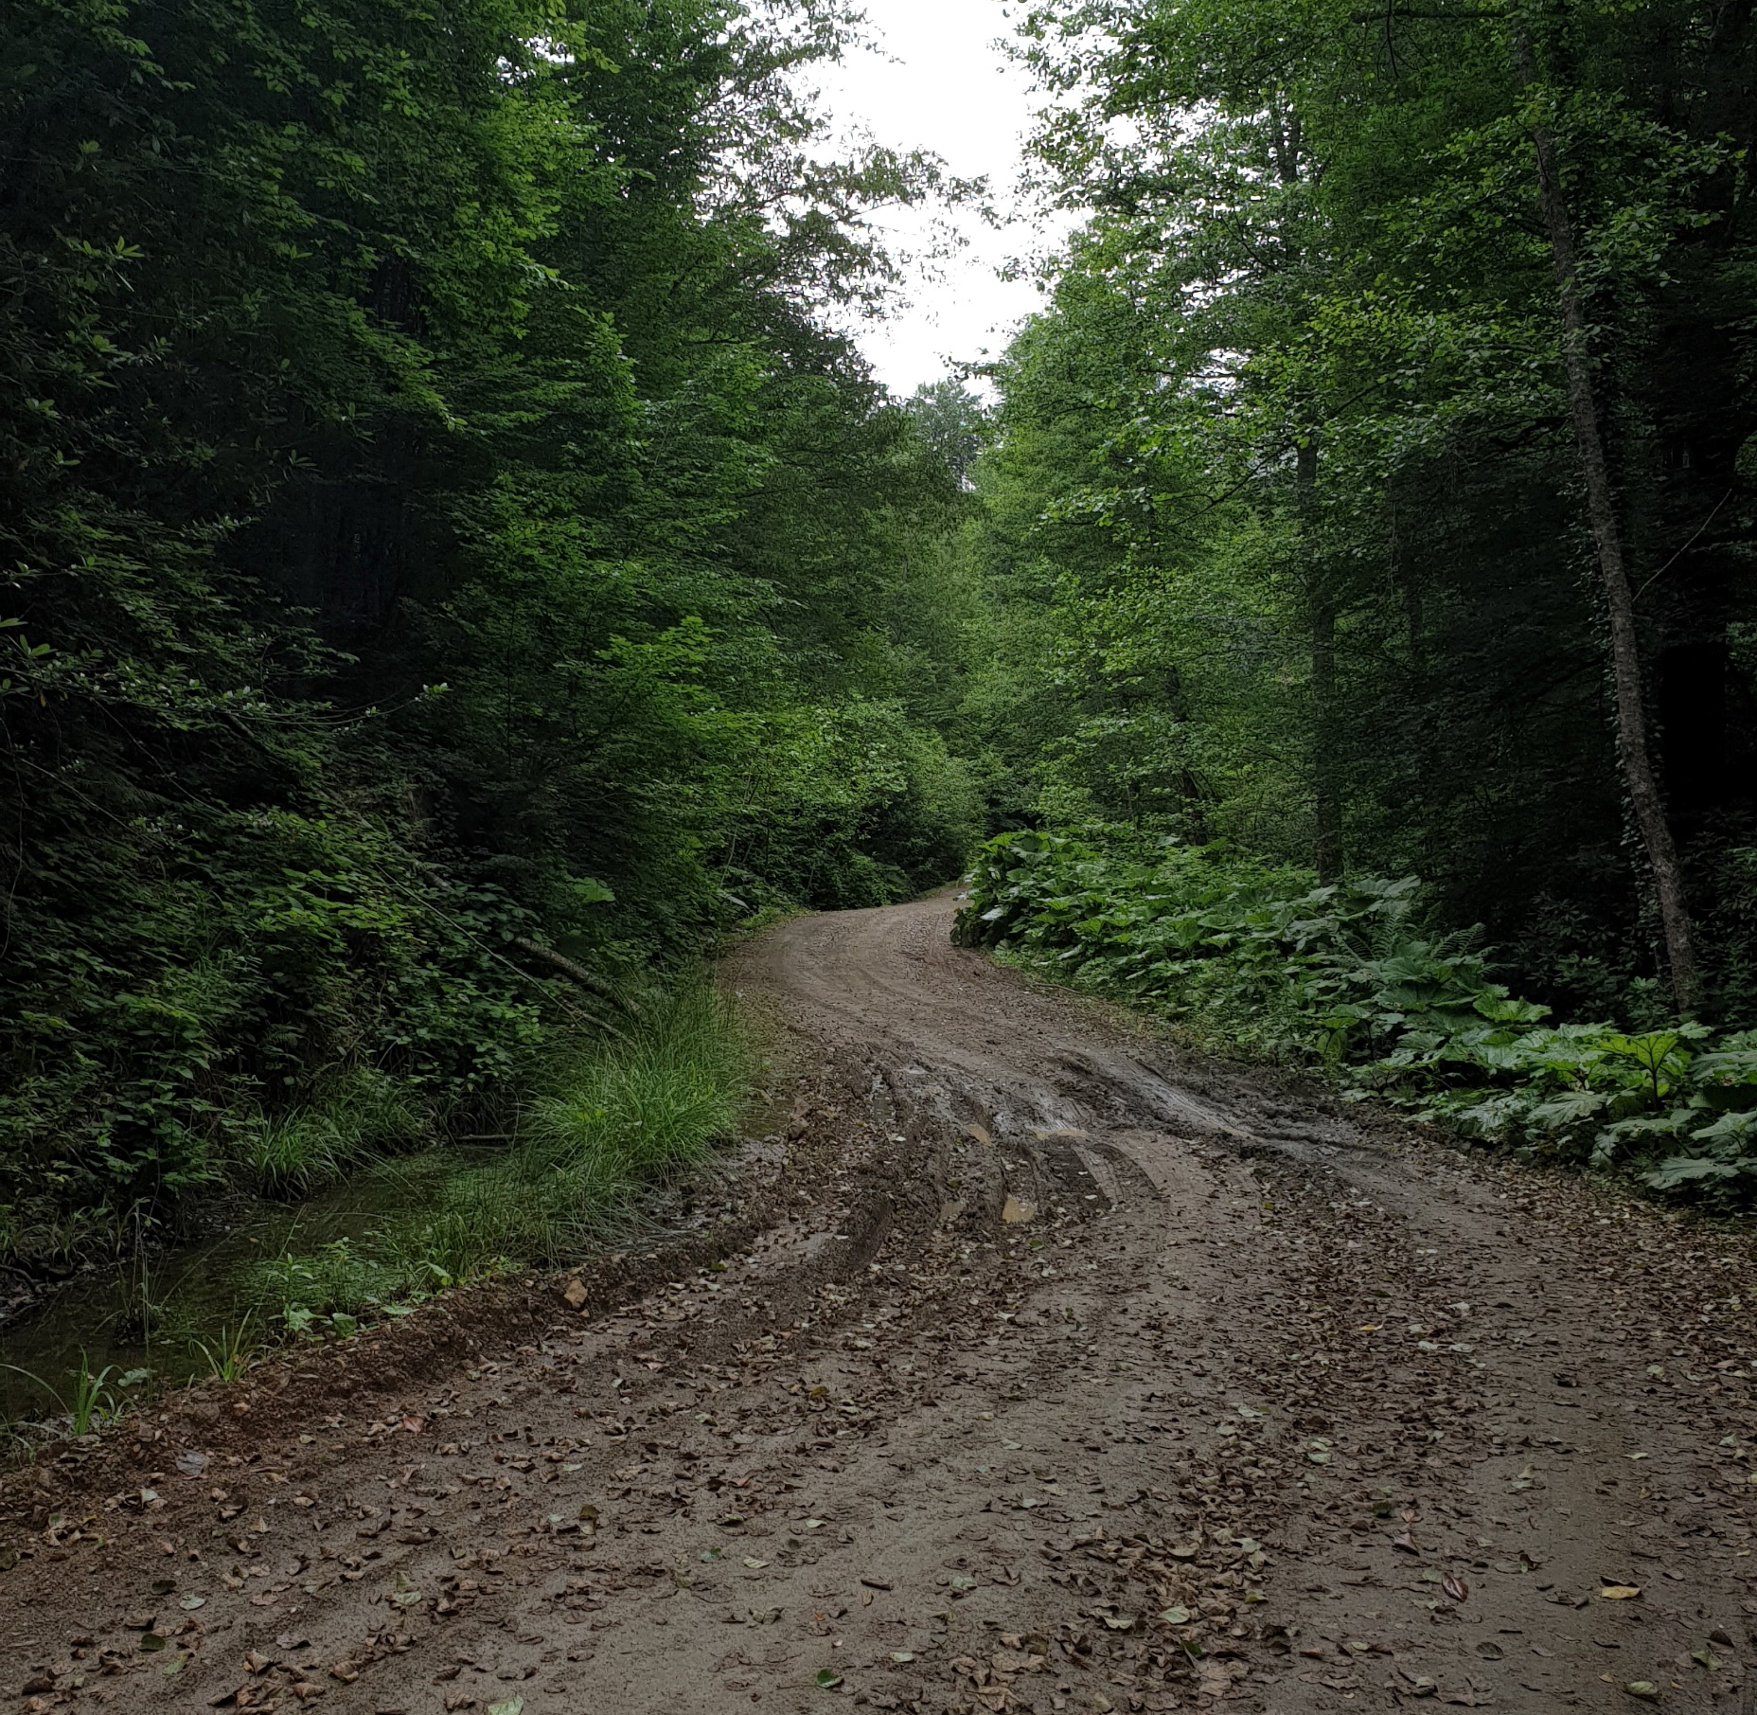
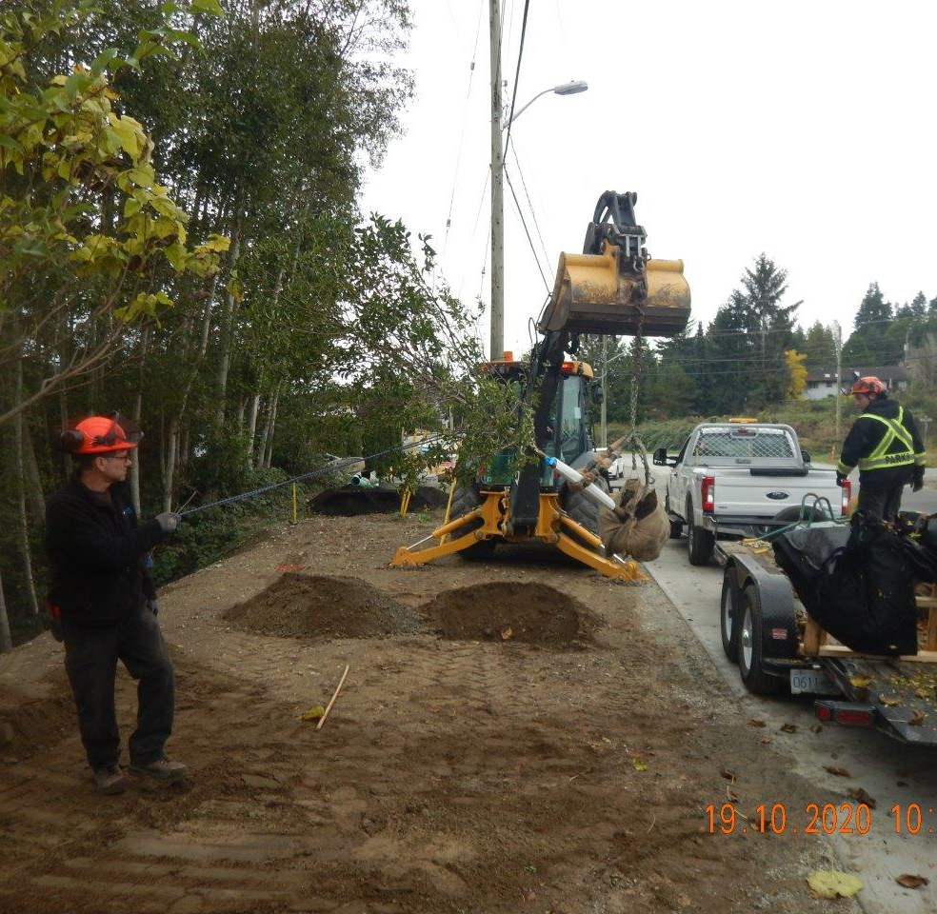
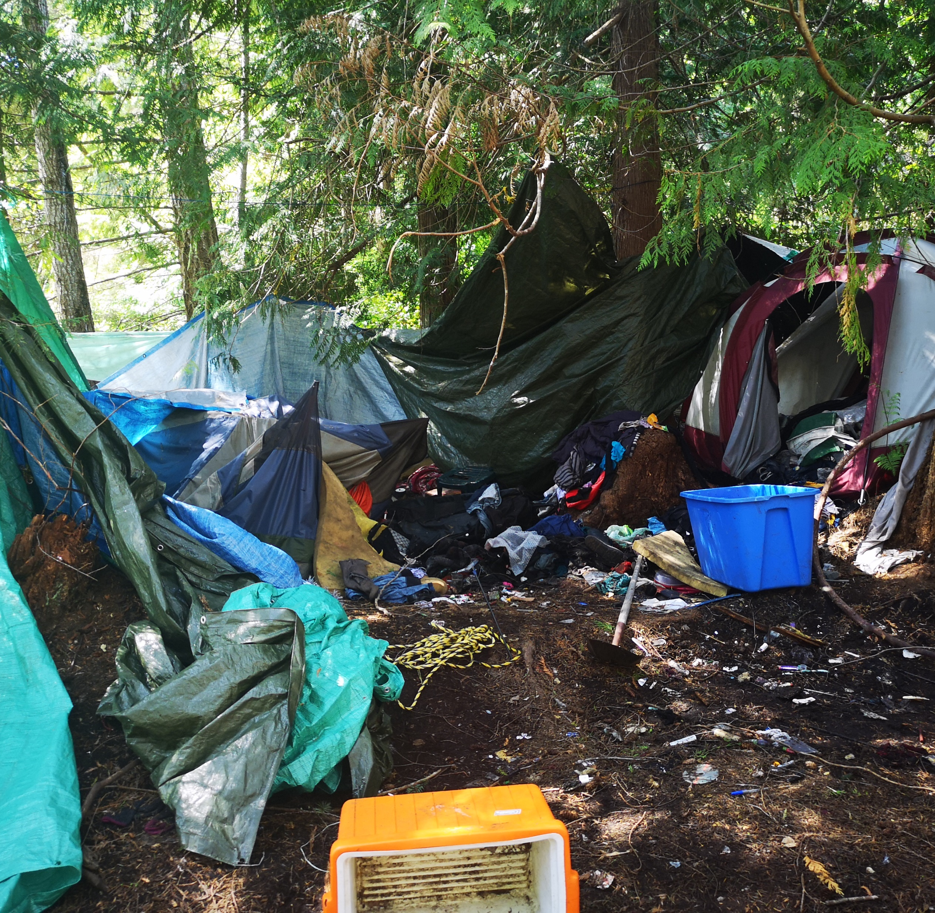
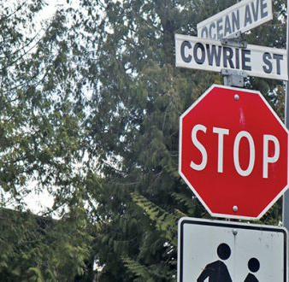
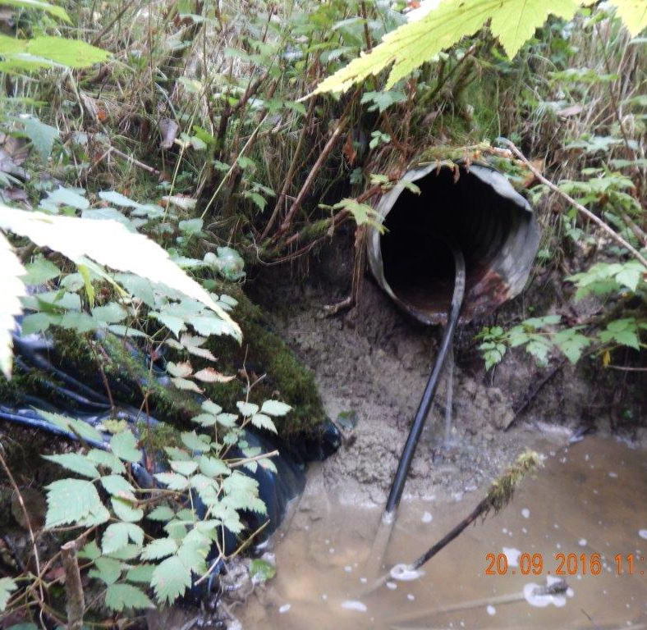
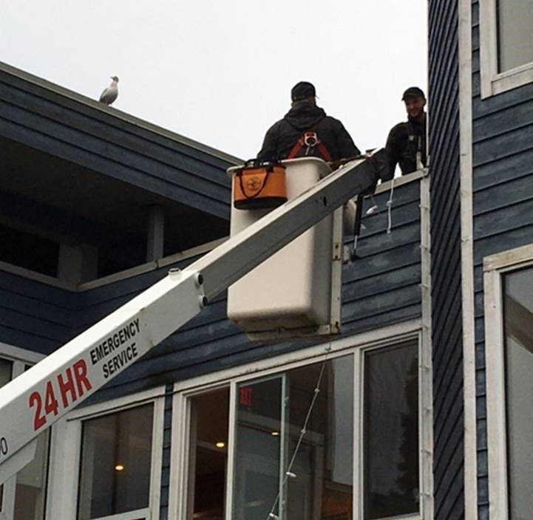
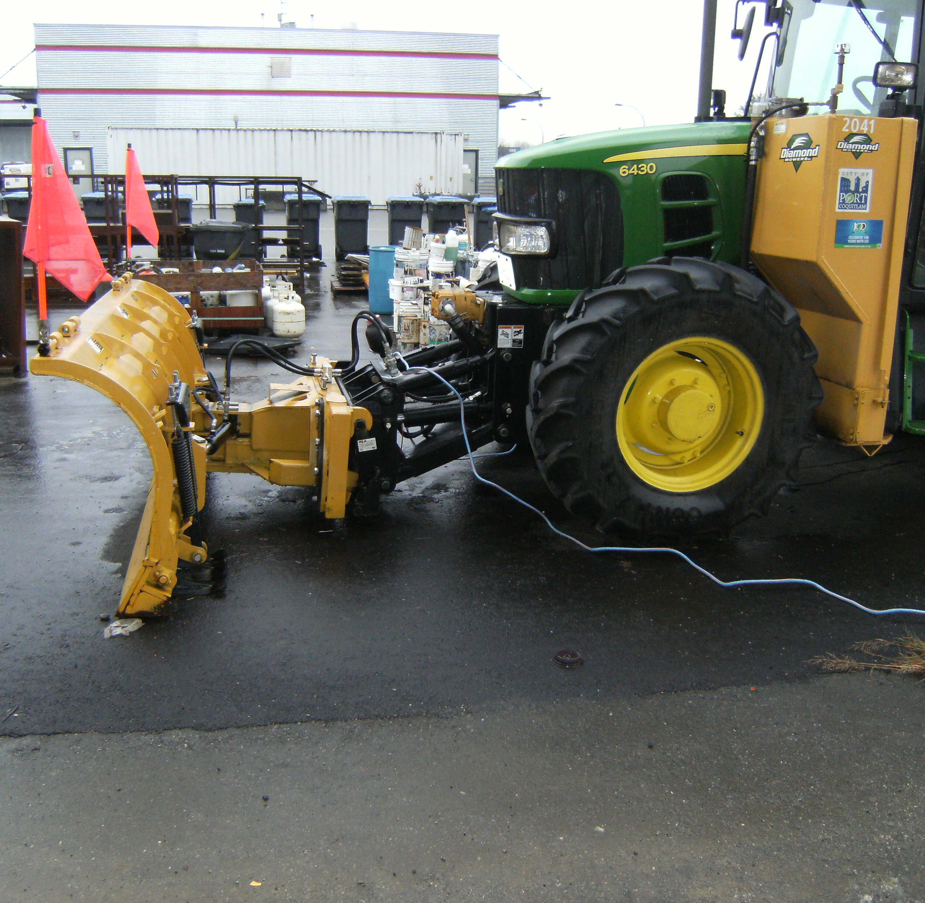
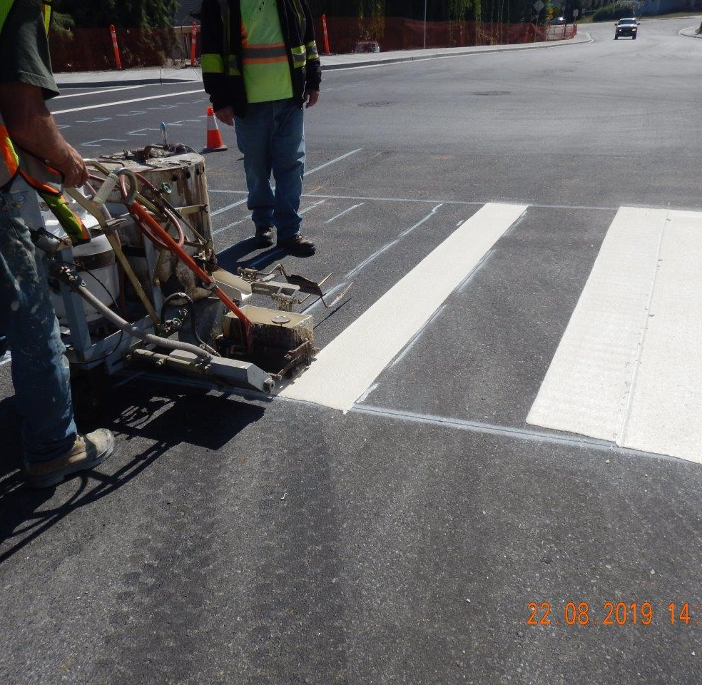
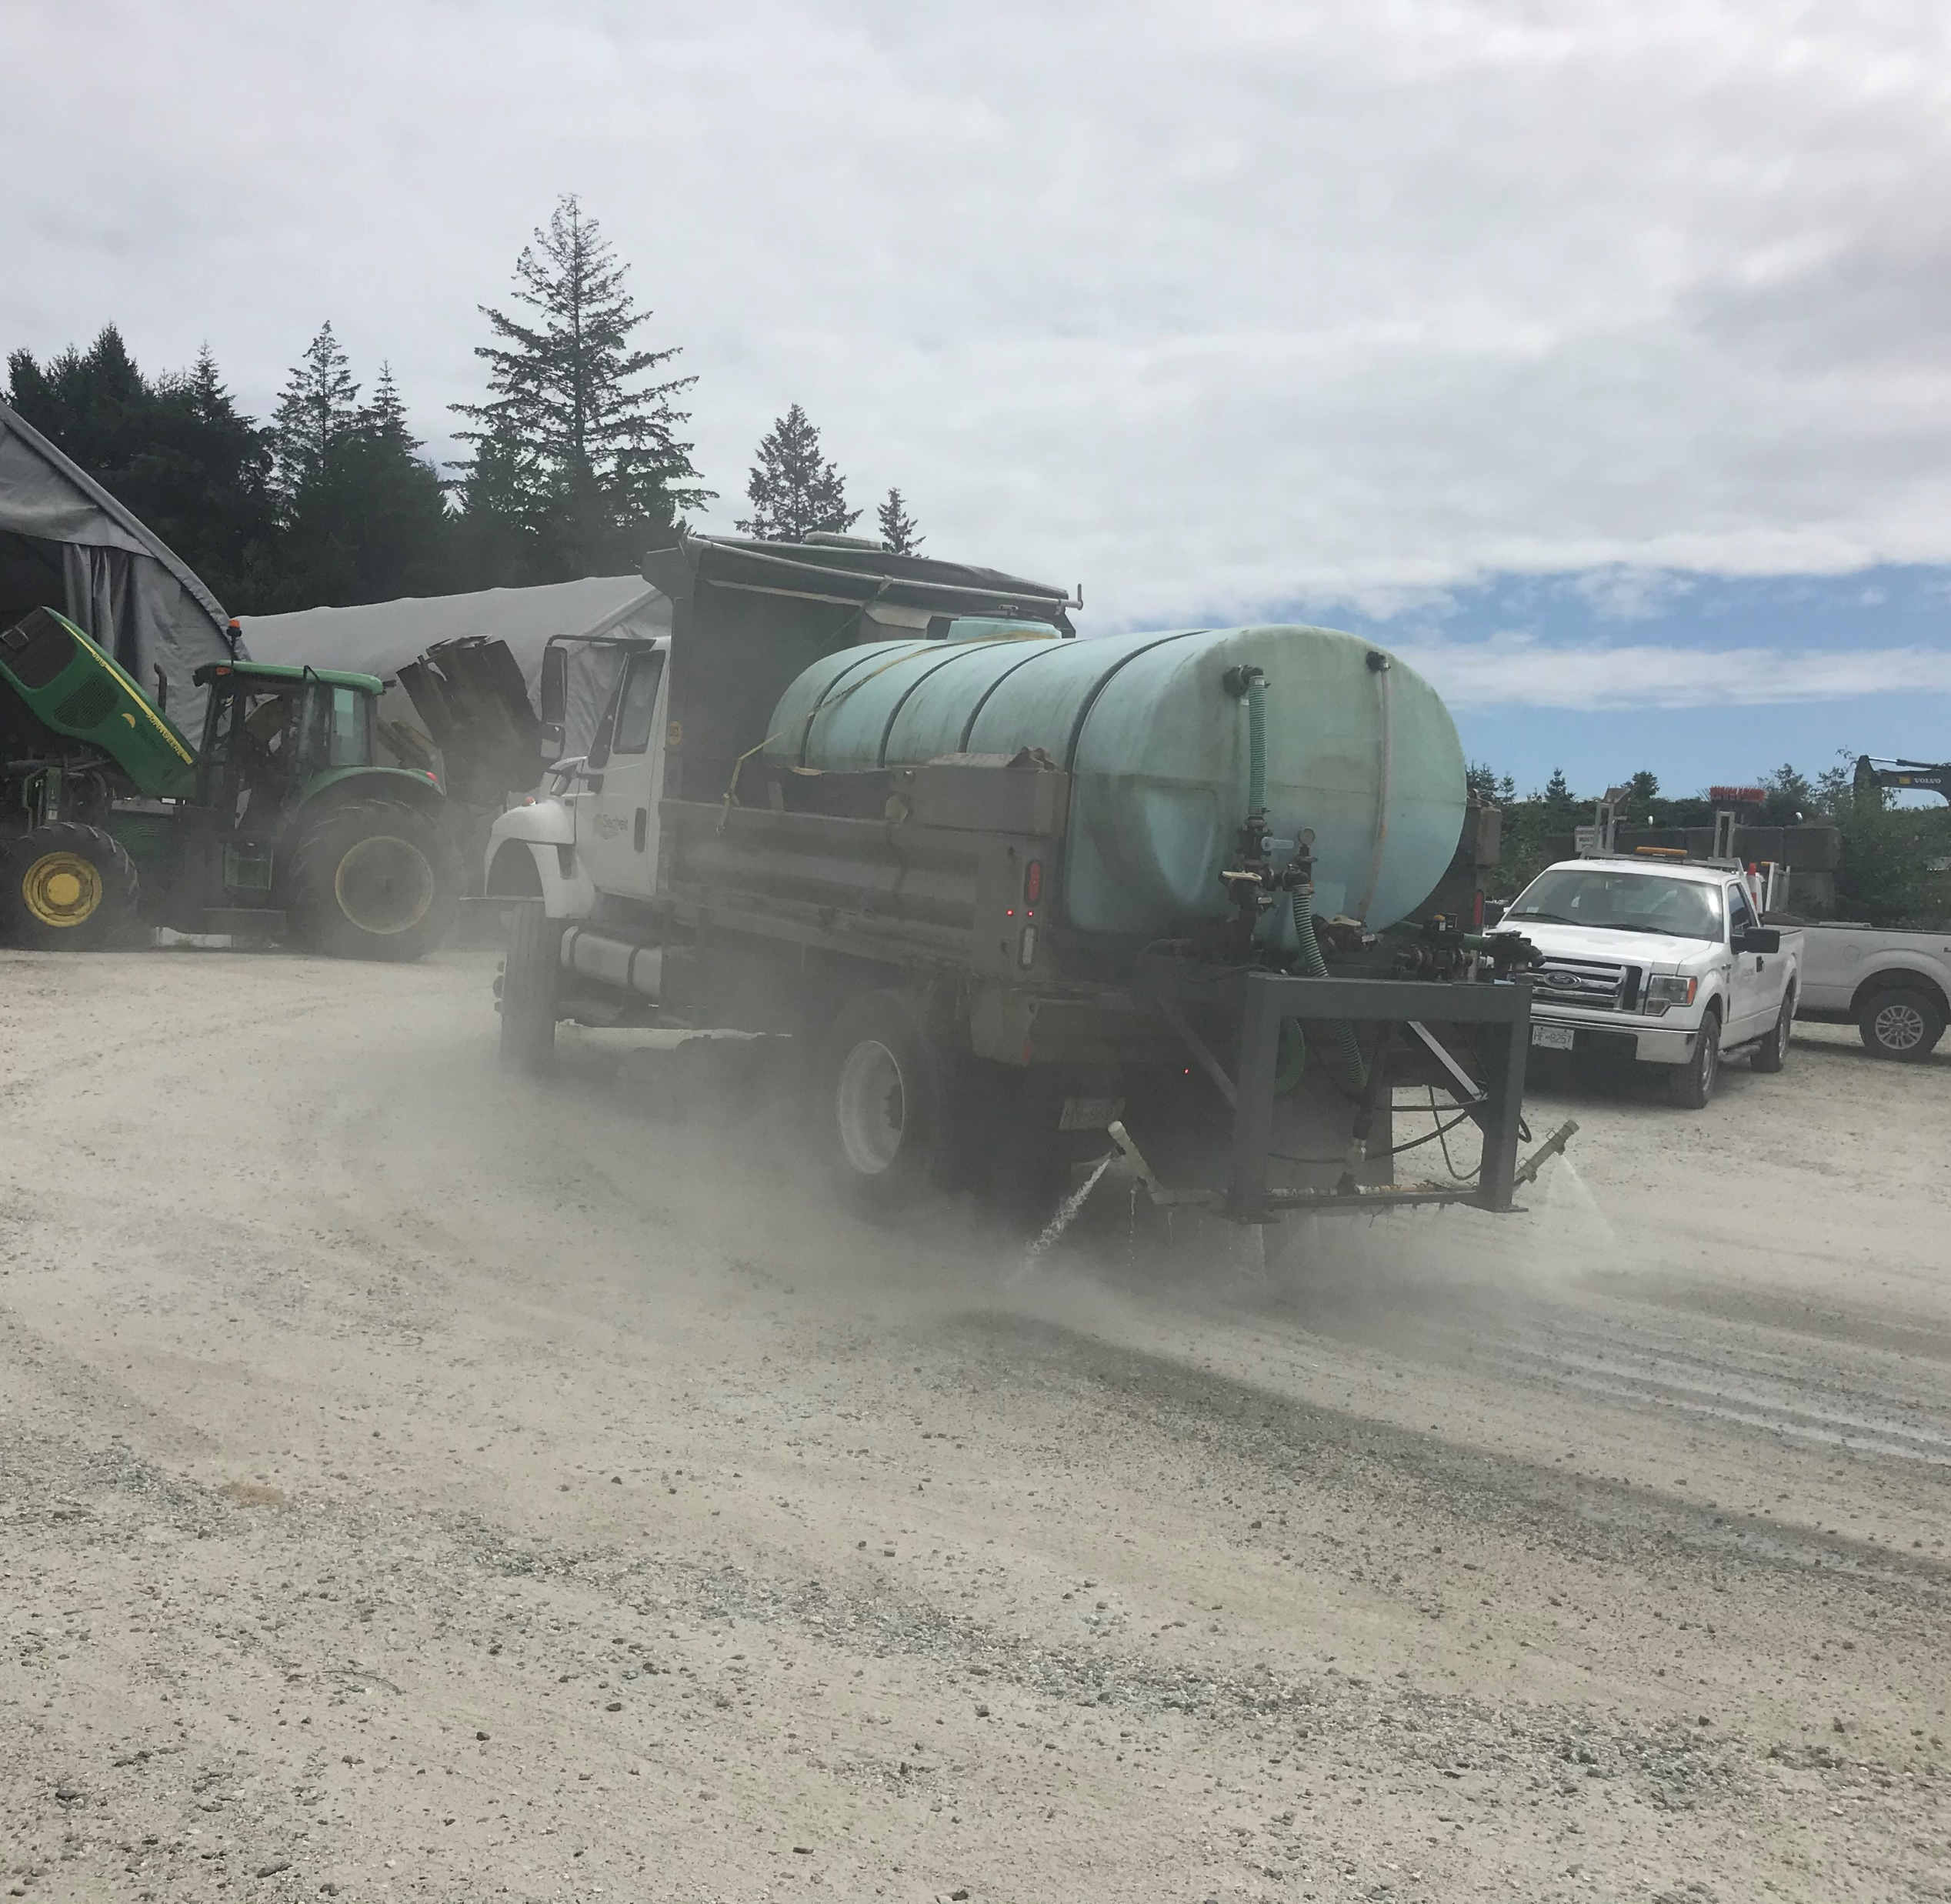
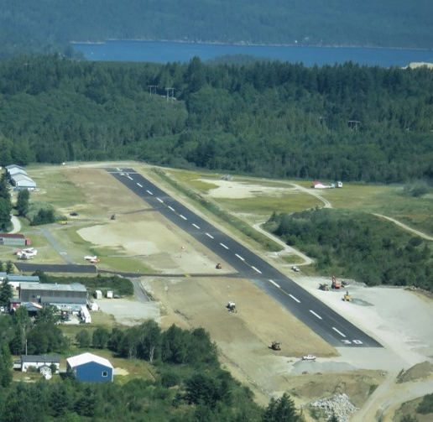
PUBLIC WORKS
DITCHING
ROAD MAINTENANCE
SIDEWALK MAINTENANCE
WHARF MAINTENANCE
SNOW AND ICE REMOVAL
ROAD GRADING
HAZARDOUS TREE REMOVAL
ENCAMPMENT CLEAN UP
ROAD SIGN MAINTENANCE
CULVERT MAINTENANCE
FACILITY MAINTENANCE
FLEET MAINTENANCE
ROAD LINE PAINTING
DUST CONTROL
AIRPORT MAINTENANCE
This Photo by Unknown Author is licensed under CC BY-SA
This Photo by Unknown Author is licensed under CC BY-SA

Slide 24
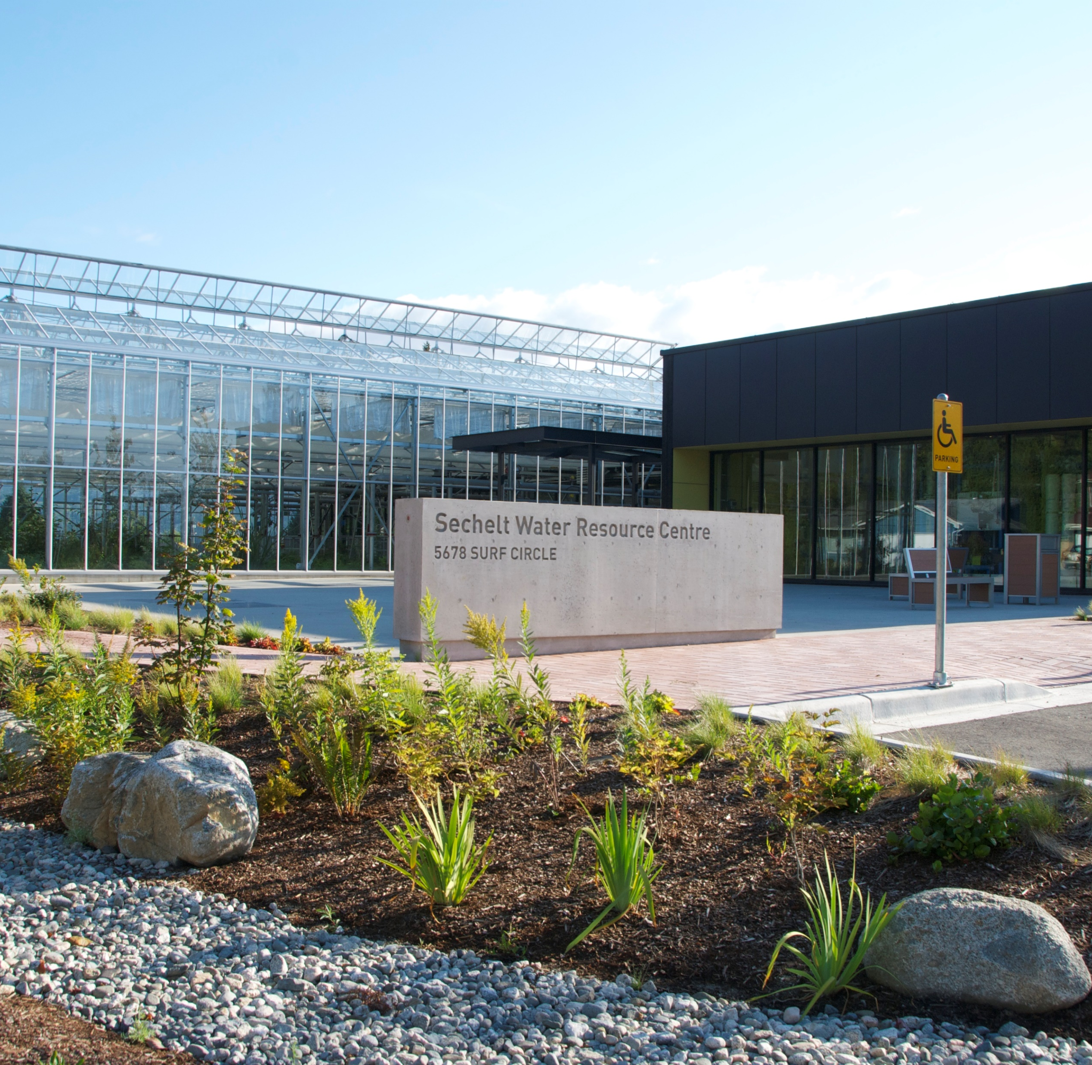
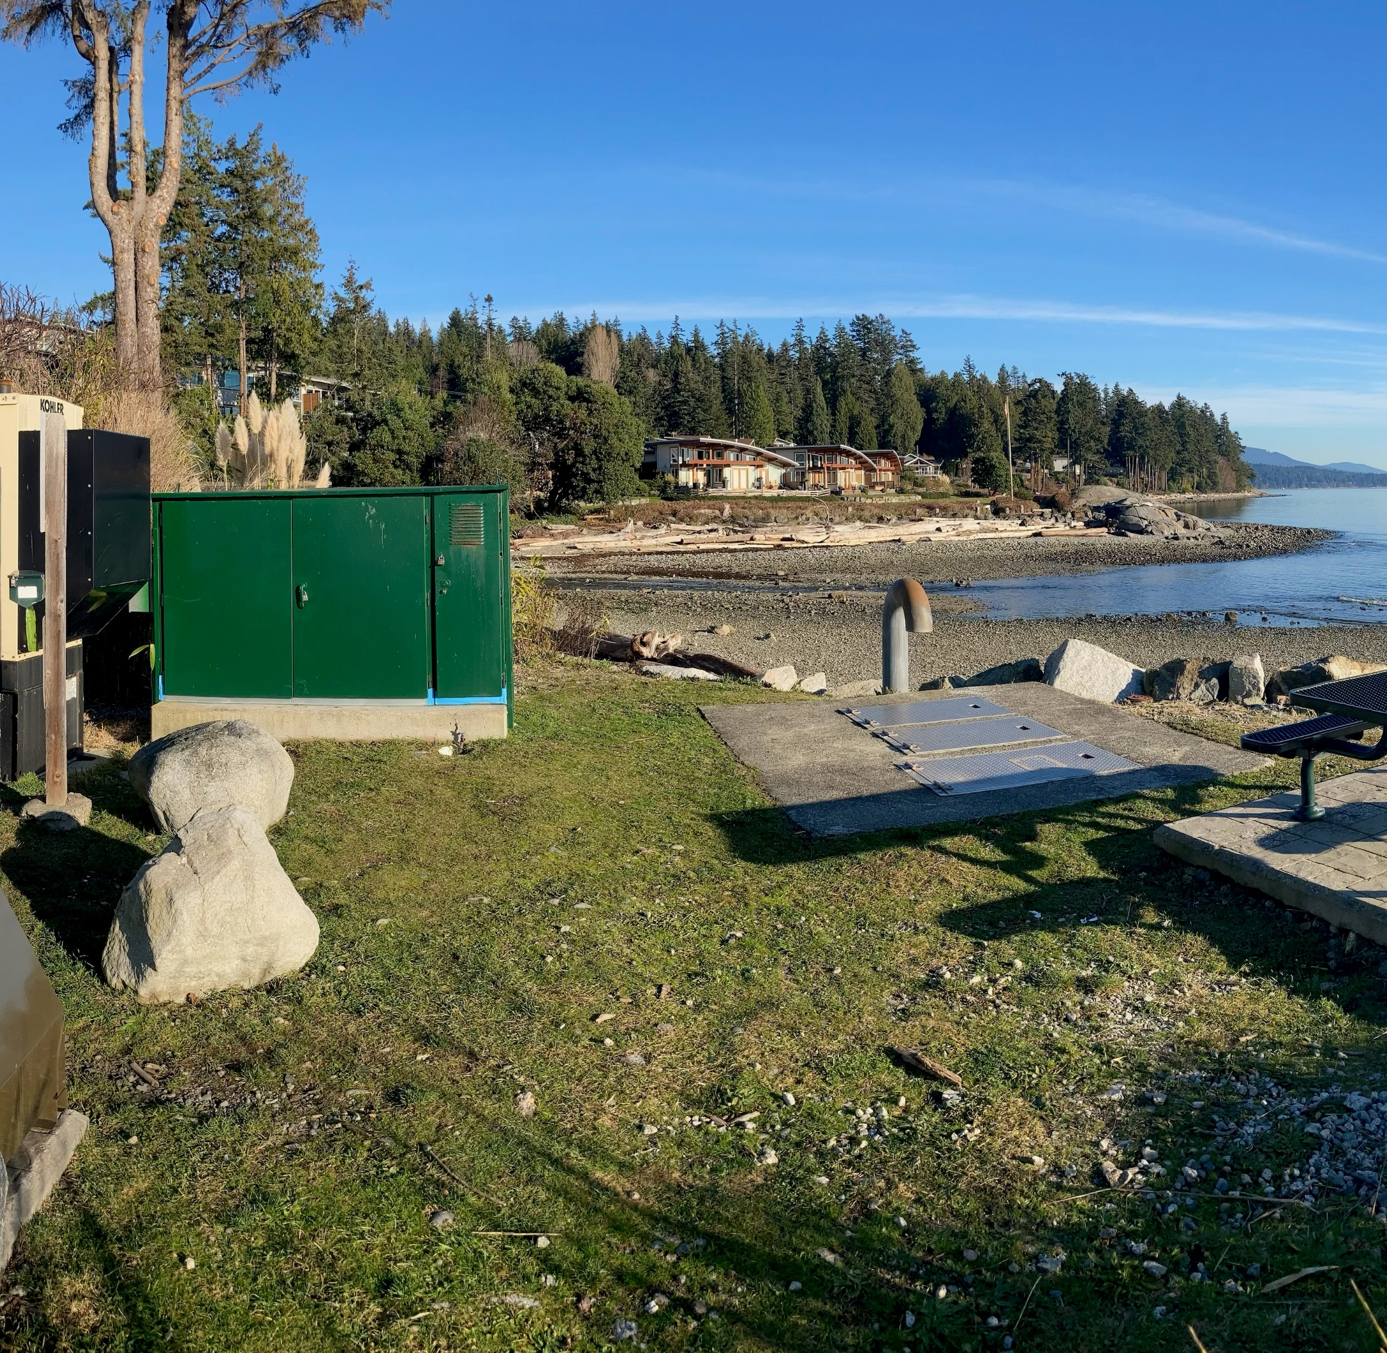
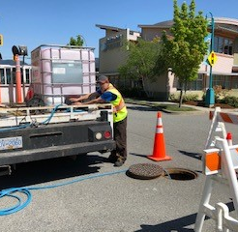
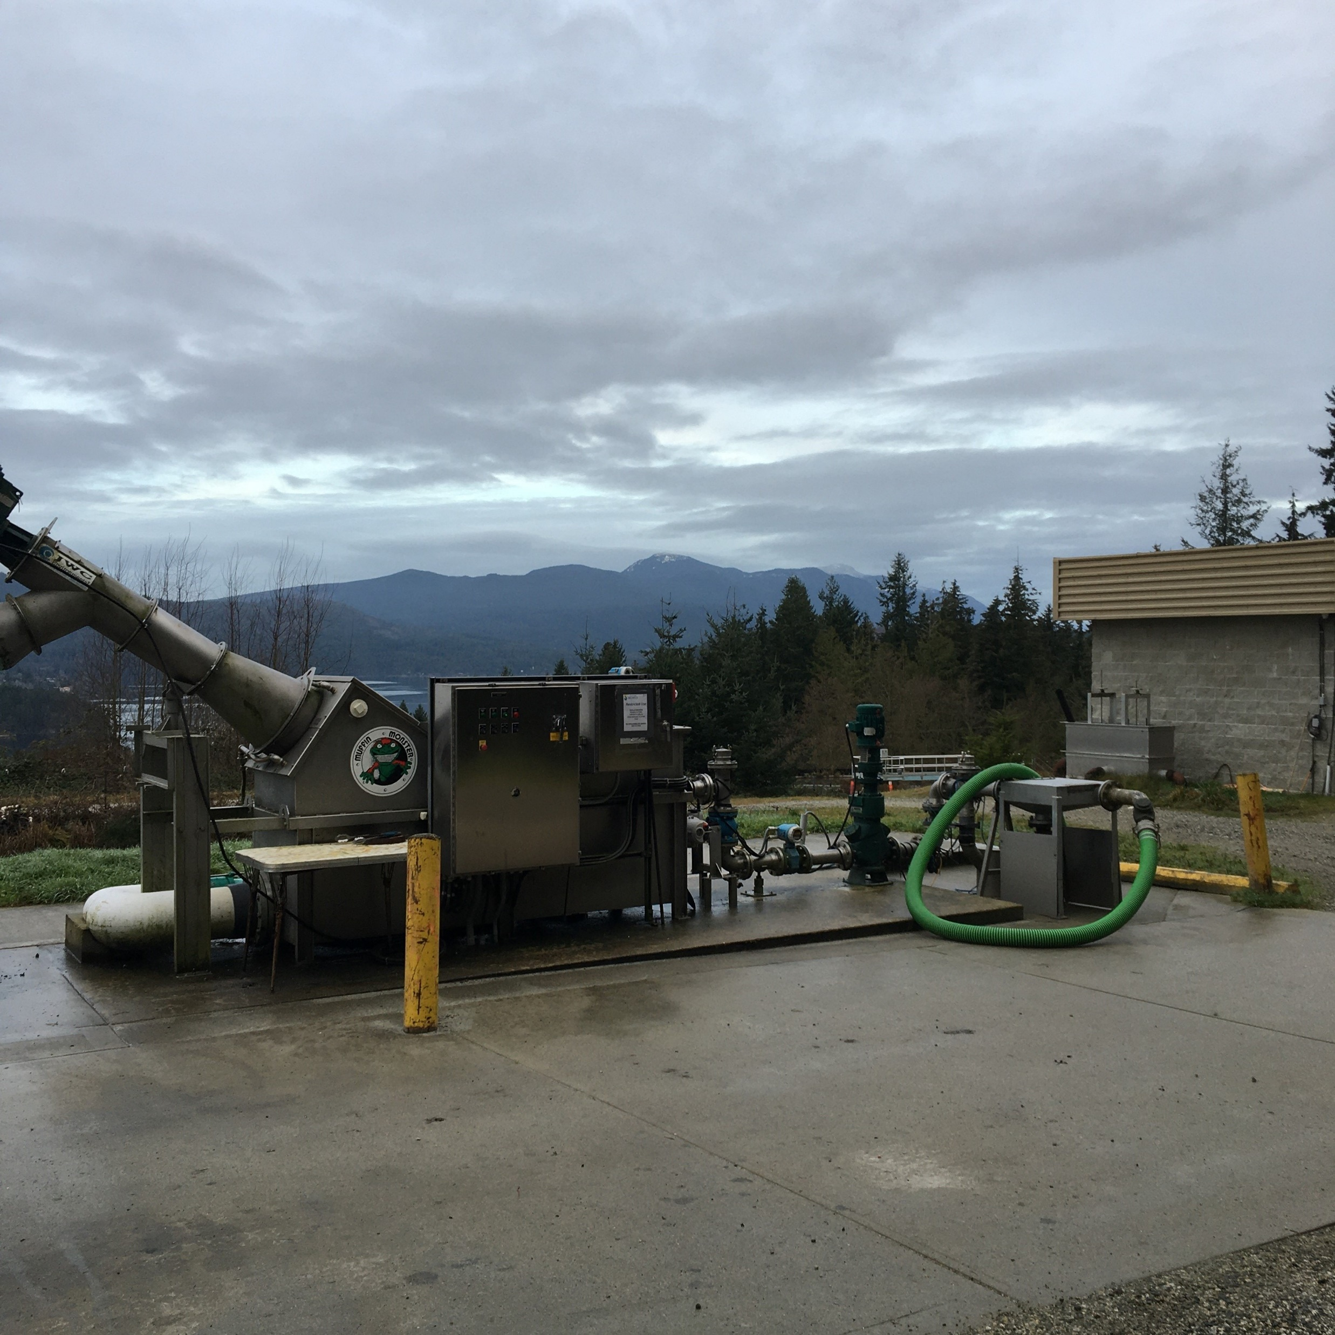
WASTEWATER
WATER RESOURCE CENTRE
COLLECTION
SYSTEM
LIFT STATIONS
SEPTAGE
RECEIVING
This Photo by Unknown Author is licensed under CC BY-SA
This Photo by Unknown Author is licensed under CC BY-SA

Slide 25
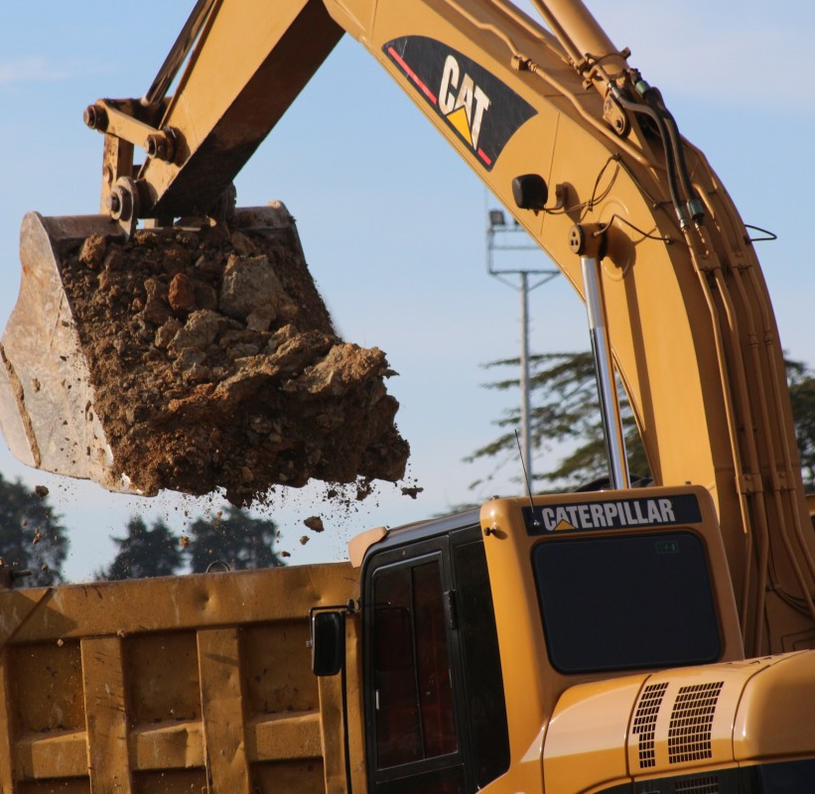
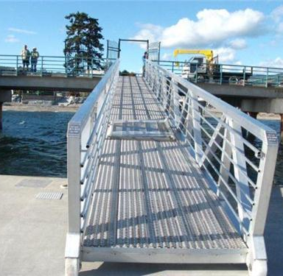
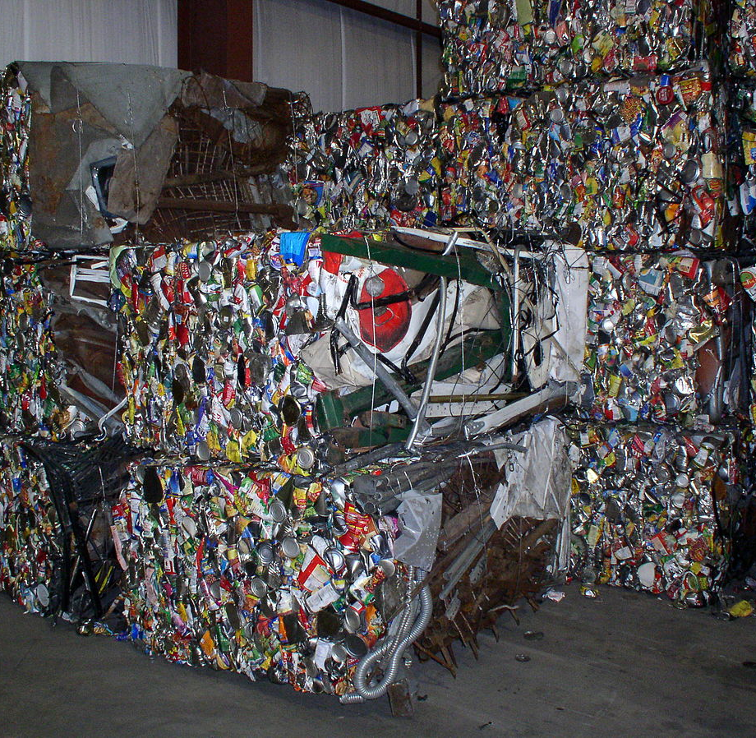
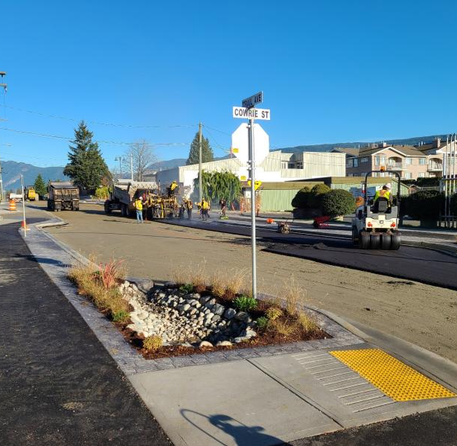
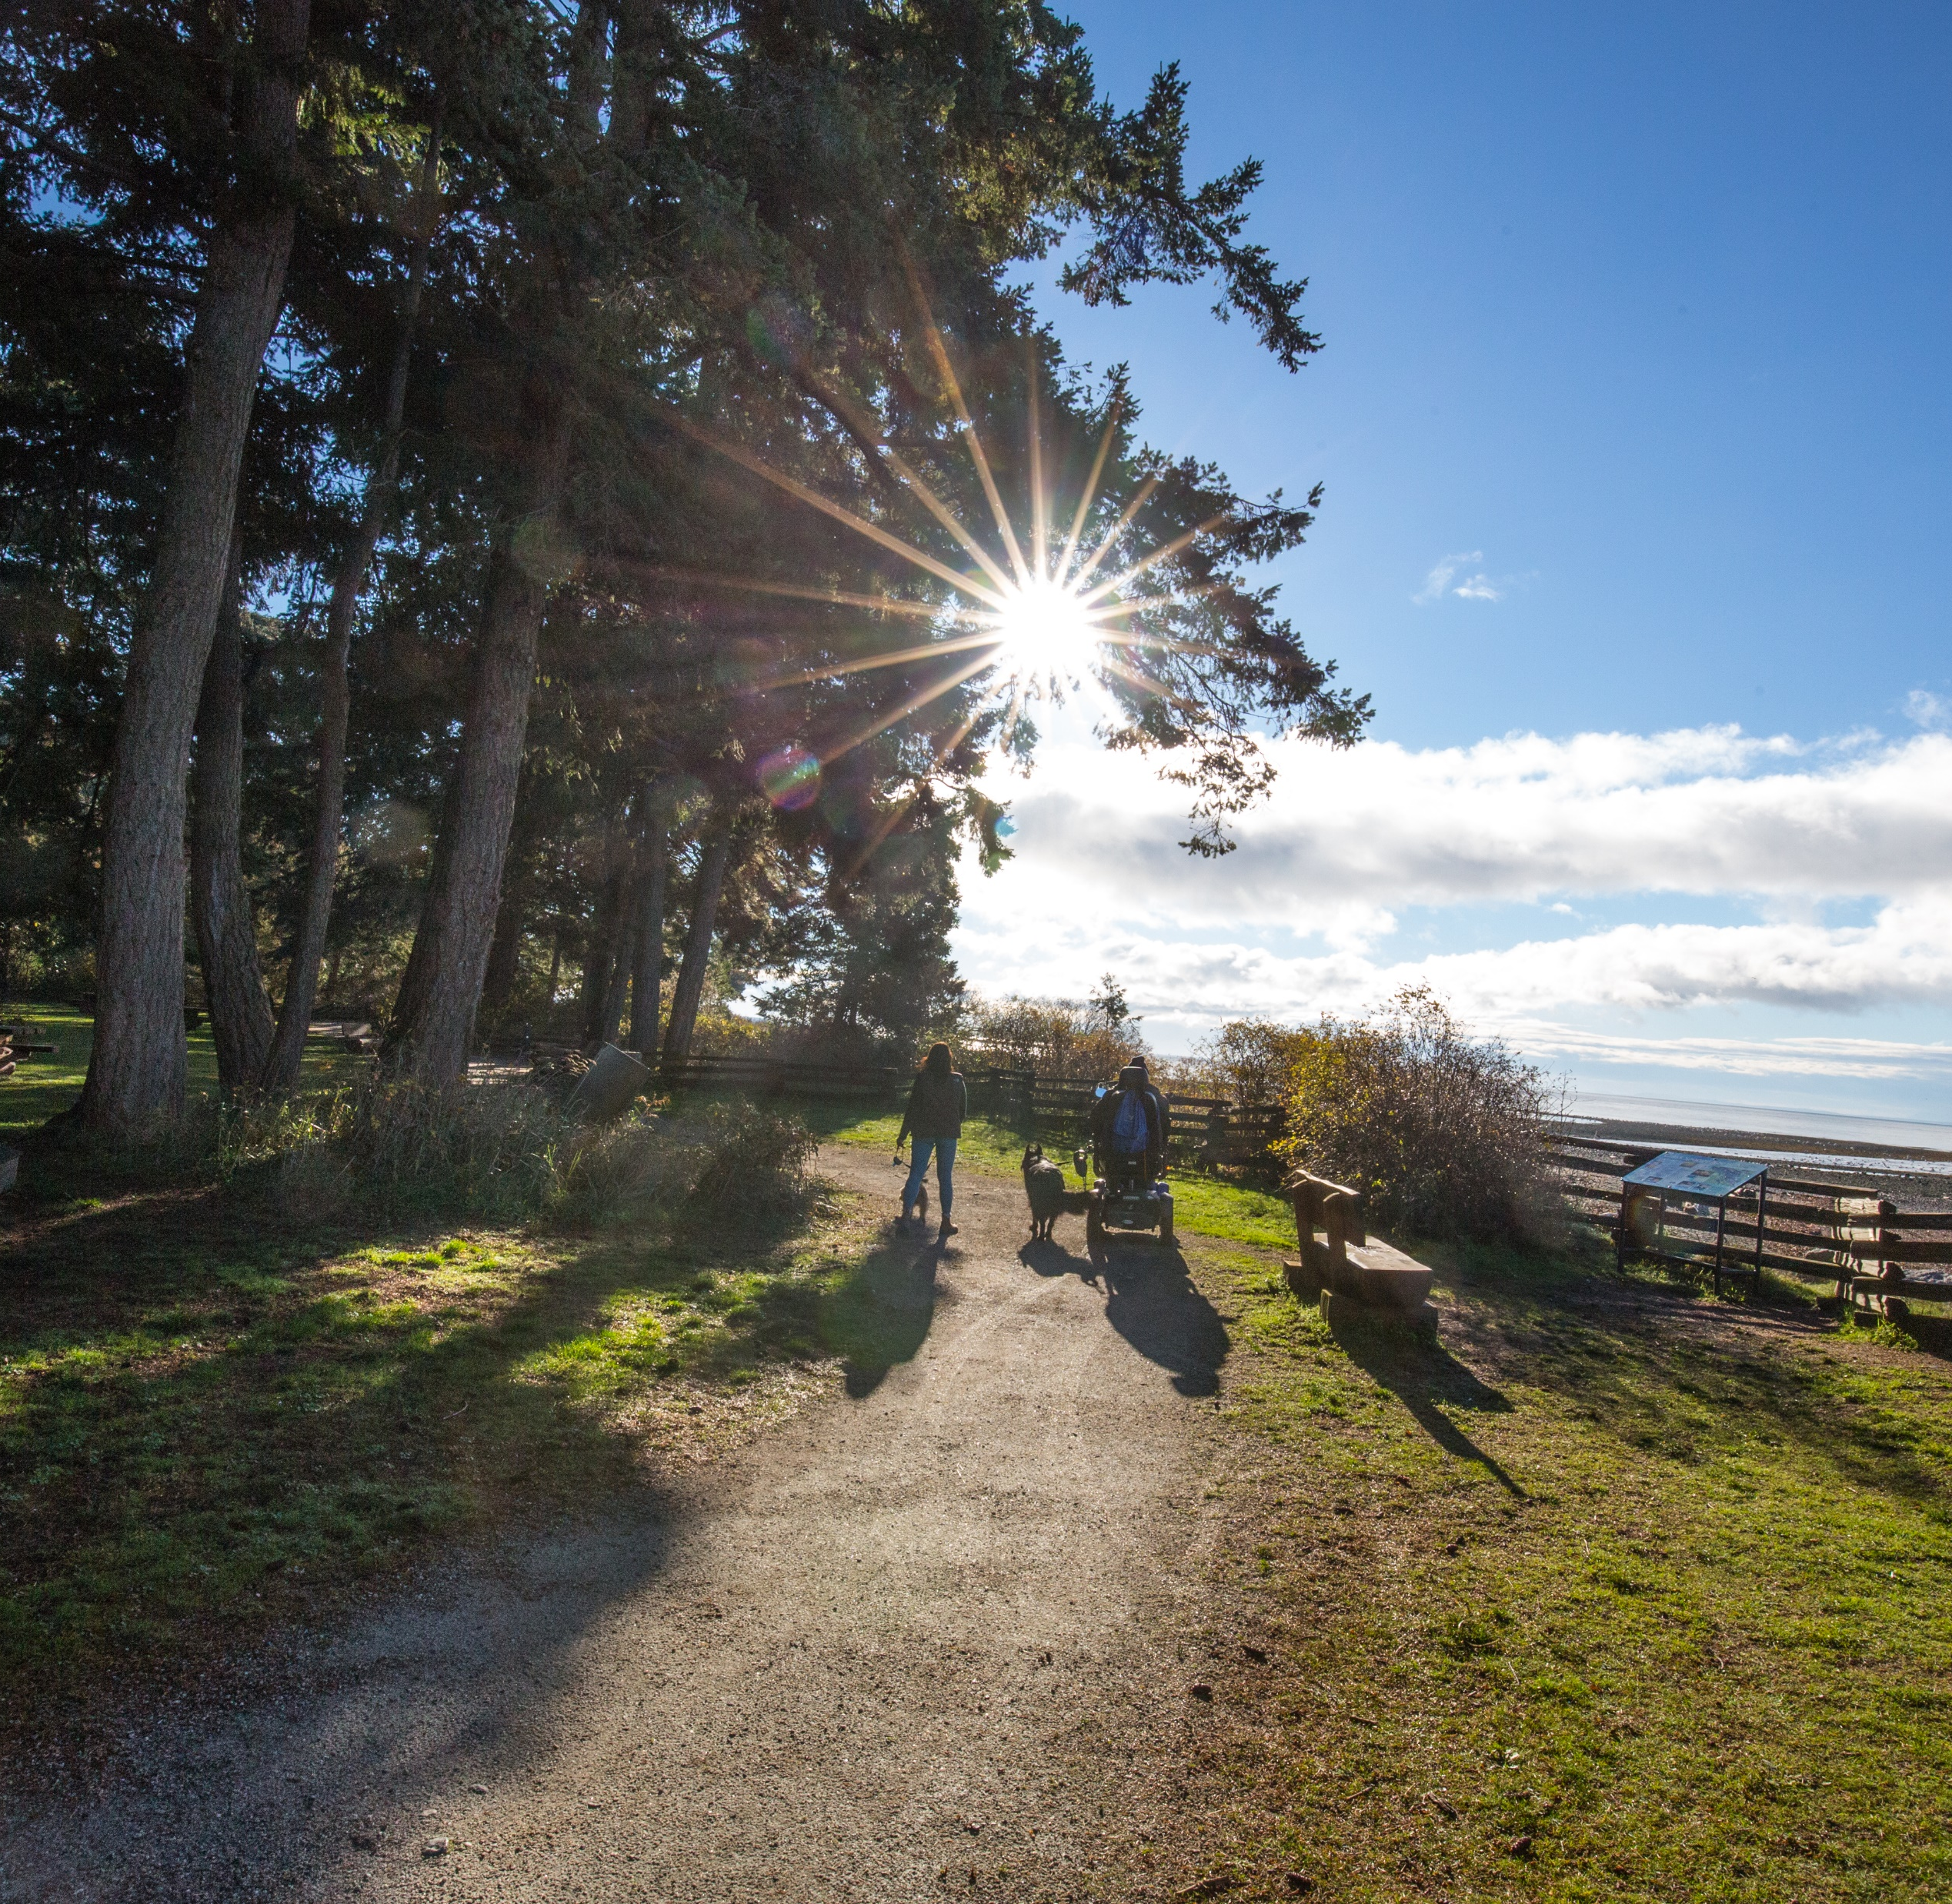
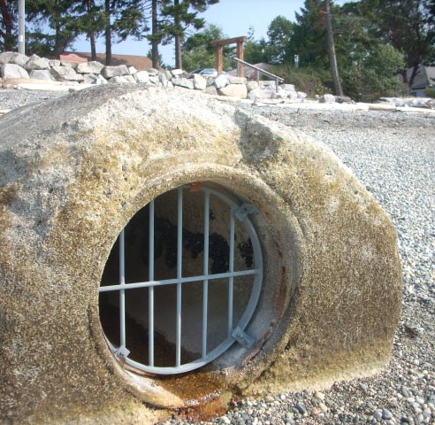

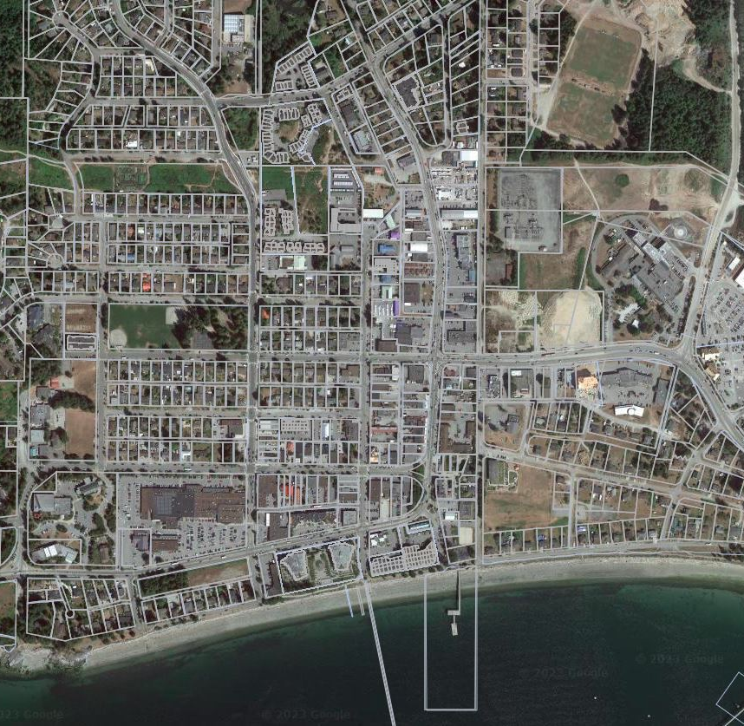
SUSTAINABLE INFRASTRUCTURE
DEVELOPMENT
ENGINEERING
ACTIVE TRANSPORTATION
PLANNING
ASSET
REPORTING
SOLID WASTE MANAGEMENT
GREEN INFRASTRUCTURE
CONDITIONS ASSESSMENTS
OVERLAND DRAINAGE, HYDROGEOLOGY AND
NATURAL ASSETS
WATER CONSERVATION
MAPPING
This Photo by Unknown Author is licensed under CC BY-SA
This Photo by Unknown Author is licensed under CC BY-SA

Slide 26
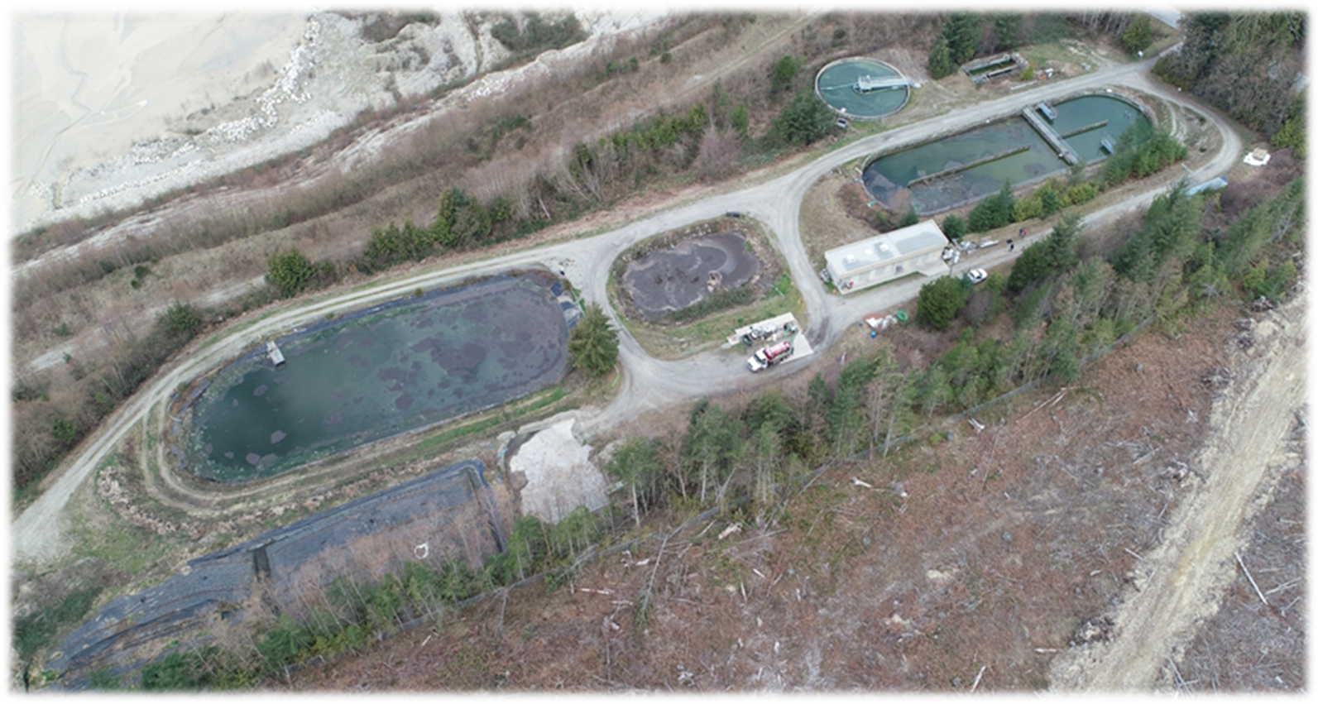
2023 Operational Projects
Transportation Master Plan
Sanitary Sewer Model and Master Plan
Septage Receiving Facility Long-term Plan
Water Resource Centre Asset Management Plan
DCC Bylaw Update

Slide 27
2024 Operational
Challenges and Opportunities
Challenge: Wastewater collection system inventory, condition assessment and maintenance lagging
Opportunity: Assign lead to Public Works, provide additional training, and add a dedicated staff member
Challenge: Water Resource Centre has no staff available to cover in case of multiple injuries and some staff are due to retire
Opportunity: Hire additional WRC staff to provide more capacity

Slide 28
2024 Operational Projects
High Priority
Drainage Master Plan
Orthophoto Imagery Acquisition
Medium Priority
Davis Bay Environmental Assessment and Archaeology
Low Priority
Sewage Outfall Environmental Impact Study
H2S Maintenance Hole Monitoring

Slide 29
2024 Operational – Budget and Staffing
Operational Budget
Includes following “Departments” –Engineering, Fleet Maintenance, Municipal Buildings, Public Works, Solid Waste, Wharfs, Wastewater and Septage
2023 - $ 9,005,678
2024 - $ 8,779,243

Slide 30
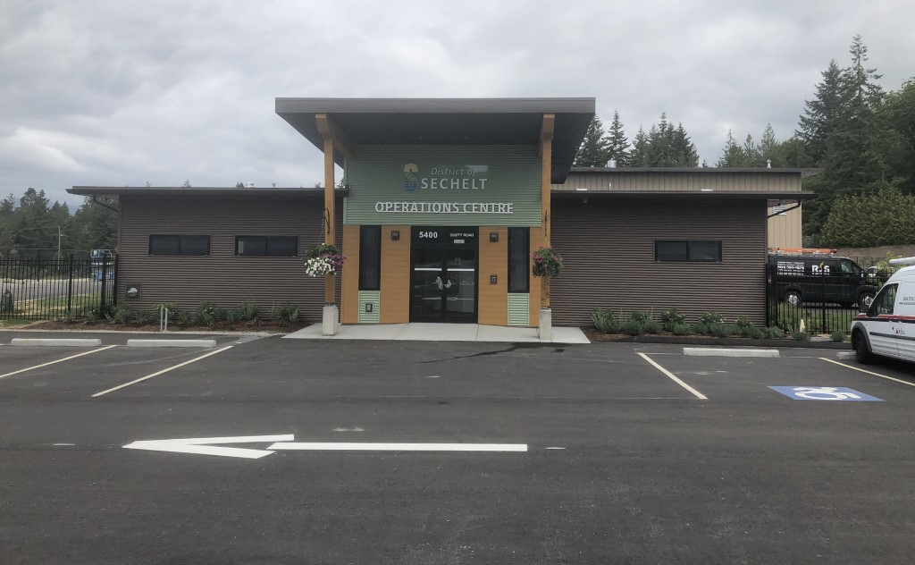
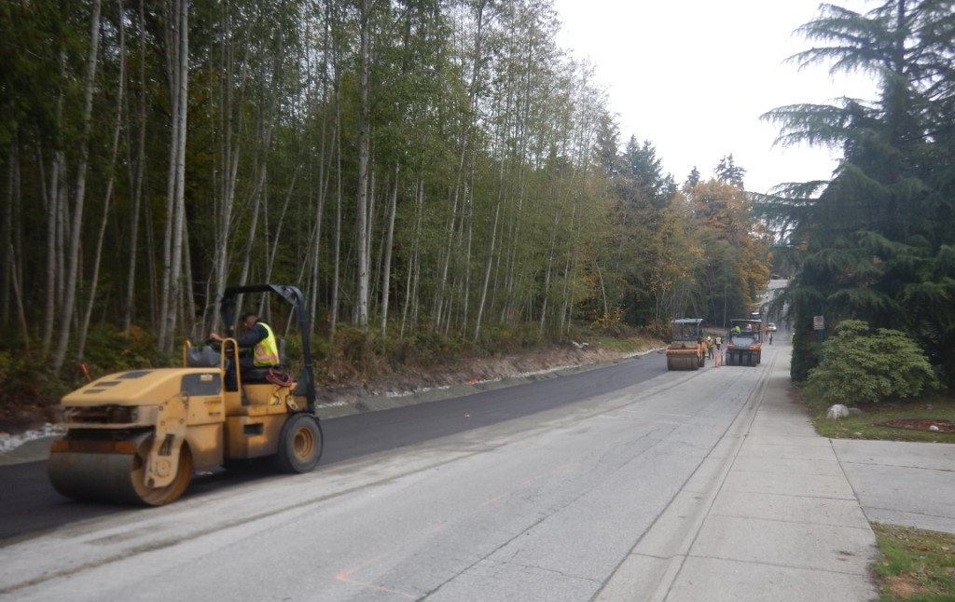
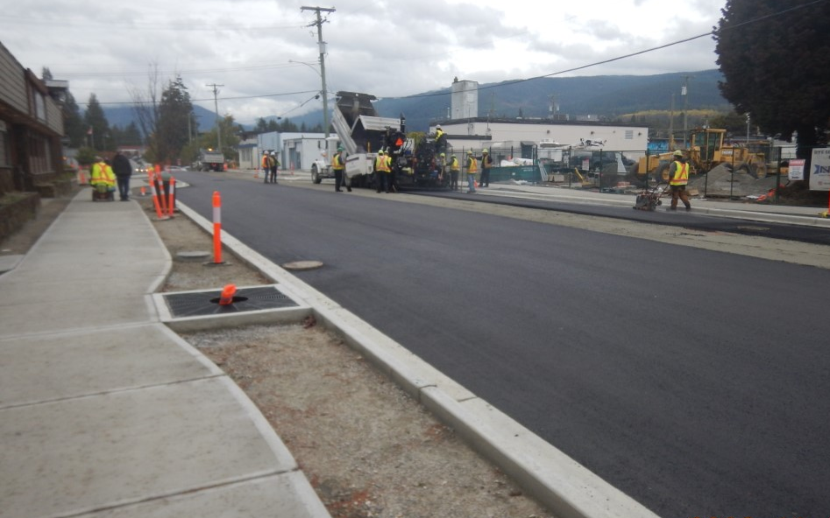
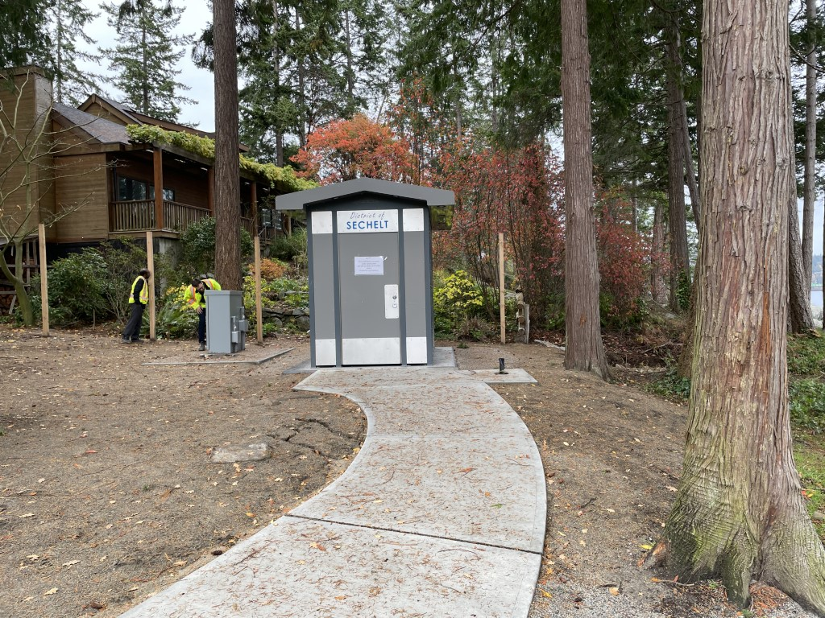
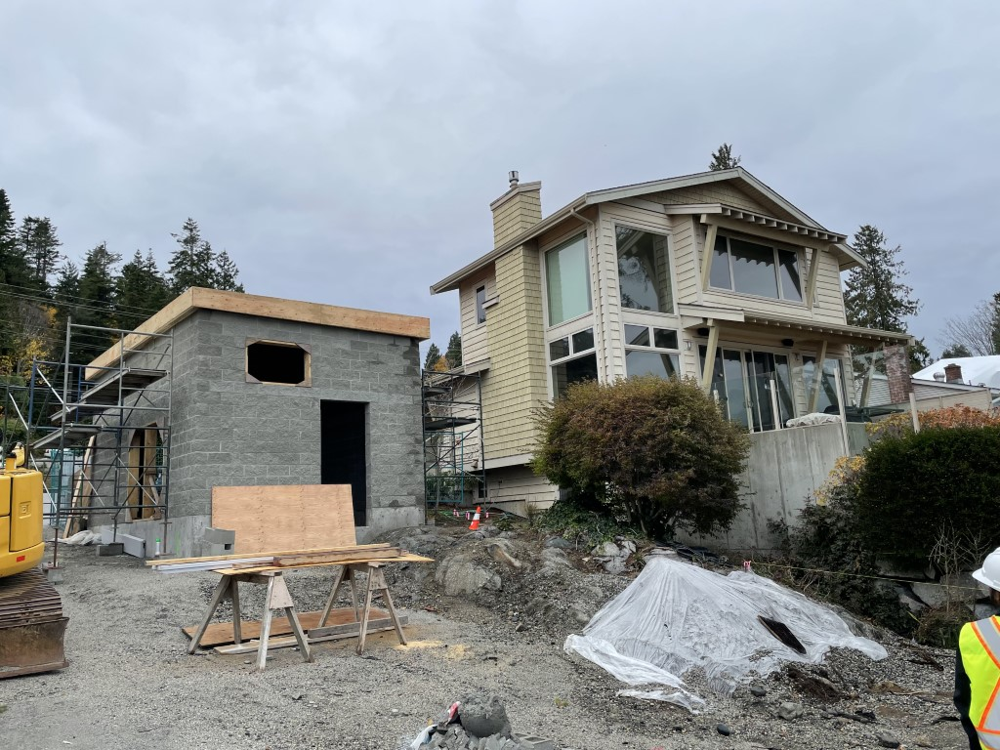
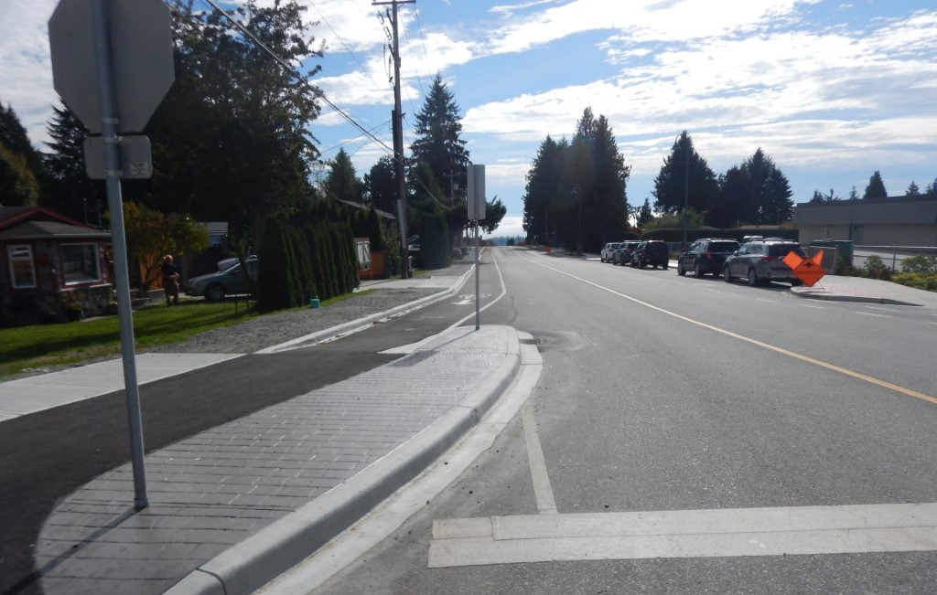
2023 Capital Highlights
Reef, Shoal and Lighthouse
Bike Lanes
Operations Centre
Snickett Park Washroom
Inlet Avenue
West Sechelt
Active Transportation
Wakefield Lift Station

Slide 31








2024 Capital Requests
$470,000
$ 3,175,000
VEHICLES / EQUIPMENT
GENERAL
$ 2,101,000
$ 1,720,000
FACILITIES AND AIRPORT
TRANSPORTATION
(ROADS, SIDEWALKS & WALKWAYS)
$ 925,000
$ 1,069,000
DRAINAGE
WASTEWATER
(SEWER AND SEPTAGE)
TOTAL: $9,460,00

Slide 32
2024 Capital Delivery Challenges
Provincial Permitting Times
  Archaeology
  Ministry of Transportation and Infrastructure
  Groundwater Wells
Local Contractor Capacity
Subtrade Availability
District staffing levels and getting through project backlog
Levels of expected engagement with other governments and lack of participation and response

Slide 33
2024 Capital Carry Forward
Capital Budget Carry Forwards: 2013 - 2023
Year | CFWD | New | Total Budget
2013 | $ 4,821,236 | $ 5,875,905 | $ 10,697,141
2014 | 572,036 | 19,708,723 | 20,280,759
2015 | 3,887,745 | 3,976,470 | 7,864,215
2016 | 1,699,173 | 2,026,600 | 3,725,773
2017 | 1,775,084 | 6,105,038 | 7,880,122
2018 | 6,108,337 | 5,888,446 | 11,996,783
2019 | 6,223,497 | 5,998,500 | 12,221,997
2020 | 10,582,594 | 5,153,114 | 15,735,708
2021 | 10,407,740 | 11,517,035 | 21,924,775
2022 | 18,968,472 | 3,913,281 | 22,881,753
2023 | 16,148,144 | 7,002,119 | 23,150,263
2024 | 14,209,685 | 11,175,900 | 25,385,585

Slide 34
Questions?

Slide 35
2024 General Government
Financial & Information Technology Services, Airport
Budget Presentation
David Douglas, Director of Financial & IT services

Slide 36
Departments
Financial
Information
Airport
Technology
Services

Slide 37
2023 Operating Review
Summary
2023 has been a busy year for the Finance department:
completing the annual budget process
Completed annual audit
reported required information to other levels of government
started the implementation of Questica budget software
collection of 2023 taxes, business licenses and dog licenses,
Issued a Request for Proposal for Audit services/Awarded contract for Audit Services
continue to work on completing the Asset Retirement Obligations requirements for PSAB.
Procurement issued 20 Request for proposals/tenders

Slide 38
2023 Operating Review
The IT department has also busy:
IT related infrastructure renewals
Audio Visual upgrades
security camera additions
help desk calls
completion of the District’s Website
setting up a cloud back-up system
Airport
Request for proposal was issued for the airport masterplan
logging of part of the airport was completed in 2023
Provide direction to the Airport Manager
Negotiated and renewed several airport leases

Slide 39
2024 Operational requests
Finance Department
Utility Billing Module – This request is to create more efficiencies within the department we are looking to separate utility billing from the taxation module. This will save many hours of processing time at our busiest time of the year, tax time.
Information Technology
The District is looking to include specific training on Office 365, staff currently use only a small portion of the available tools included in the software. Bringing in a specialist to enhance our knowledge will increase our overall efficiencies in all divisions.
.

Slide 40
2024 Capital Requests
Information Technology
3 projects have been asked for from the Information Technology all are themed around infrastructure replacement and security enhancements:
Information technology infrastructure Replacements
Server room upgrades
Security enhancements

Slide 41
Conclusion
Strategic summary
Financial Services and Information Technology Services projects are close be being completed and should be by the end of the year. The focus for the two departments is creating efficiencies for department and District staff through specific software training and adding a software module for utility billing. These projects align with Council priorities under Ensuring Financial Balance by efficiently managing core services.

